Slide 1
中科汇联问答系统 lucene 检索性能的提高
刘 荣
北京中科汇联信息技术有限公司
2014-12-11

Slide 2
目录
lucene search
1. TFIDF Similarity
2. problem of search multi-filed
3. improvement in search
4. z-mert optimization

Slide 3
Lucene 检索--TFIDF Similarity
Lucene Conceptual Scoring Formula
Description for Formula
1. Query-boost for the query (actually for each query term) is known when search starts.
2. Query Euclidean norm |V(q)| , There are two good reasons to keep this normalization.
2.1 Recall that Cosine Similarity can be used find how similar two documents are.
2.2 Applying query normalization on the scores helps to keep the scores around the unit vector, hence preventing loss of score data because of floating point precision limitations.

Slide 4
Lucene 检索--TFIDF Similarity
Lucene Practical Scoring Formula
Description for Formula
1. tf(t in d)
2. idf(t)
3. coord(q,d)
coord(q,d) is a score factor based on how many of the query terms are found in the specified document.
4. t.getBoost()
t.getBoost() is a search time boost of term t in the query q .like “jakarta^4 apache”,4 is the term boost
5. norm(t,d) :encapsulates a few (indexing time) boost and length factors

Slide 5
Lucene 检索--TFIDF Similarity
Lucene Practical Scoring Formula
Description for Formula
6. queryNorm

Slide 6
Lucene 检索-- multi field search
Multi-field search
1. query search(booleanQuery)
Q= q1 or q2 or q3. which q1 is searching field1,q2 is searching field2…
q1= term1 or term2 or term3.
Problem in multi-field search
1. queryNorm calculated
$q1(sumOfSquaredWeights)={q1.getBoost()}^{2}×\sum_{t in q1}{{(idf\left(t\right)∗t.getBoost)}^{2}}$
$Q\left(sumOfSquaredWeights\right)=\sum_{q in Q}{q(sumOfSquaredWeights)}$
$queryNorm(Q)=\frac{1}{\sqrt{Q\left(sumOfSquaredWeights\right)}}$
$queryNorm(q1)=queryNorm\left(Q\right)×q1.getBoost$
so the queryNorm for every single query is not independent . When some field contain unusual word that doesn’t match key word. It is influence the result.

Slide 7
Lucene 检索-- multi field search
Multi-field search
1. query search(booleanQuery)
Q= q1 or q2 or q3. which q1 is searching field1,q2 is searching field2…
q1= term1 or term2 or term3.
Problem in multi-field search
1. queryNorm calculated
2. coord calculated
coord(q1,field)= max_contain_word/query_word.
max_contain_word : how many of the query terms are found in the specified document
query_word : how many of query terms
coord(Q) = max_contain_query/query_number
max_contain_query : how many of the query that score is not zero.
query_number : how many of the query
so it influence the result if it have some field that is not important.

Slide 8
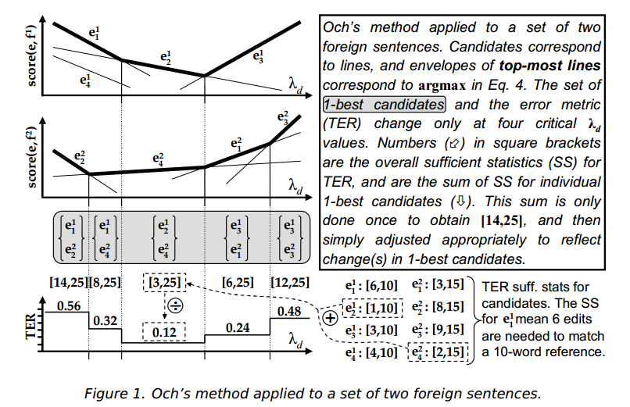
Lucene 检索-- MERT
MERT
1. maximum score
$score\left(e_{k},f\right)=\sum_{m=1}^{M}{λ_{m}φ_{m}(e_{k},f)}$.
where f-foreign sentence , canditate set for f be {$e_{1}$, $e_{2}$,.. $e_{K}$}. feature vector $φ(e,f)$={$φ_{1}(e,f)$ …$φ_{M}(e,f)$}
2. parameter estimation using Och’s Method
2.1 fix the $d^{th}$ dimension
$score\left(e_{k},f\right)=λ_{d}φ_{d}\left(e_{k},f\right)+\sum_{m≠d}{λ_{m}φ_{m}(e_{k},f)}$.
2.2 vary $λ_{d}$

Slide 9
Lucene 检索-- MERT
MERT
2. parameter estimation using Och’s Method
2.1 fix the $d^{th}$ dimension
$score\left(e_{k},f\right)=λ_{d}φ_{d}\left(e_{k},f\right)+\sum_{m≠d}{λ_{m}φ_{m}(e_{k},f)}$.
2.2 vary $λ_{d}$

Slide 10
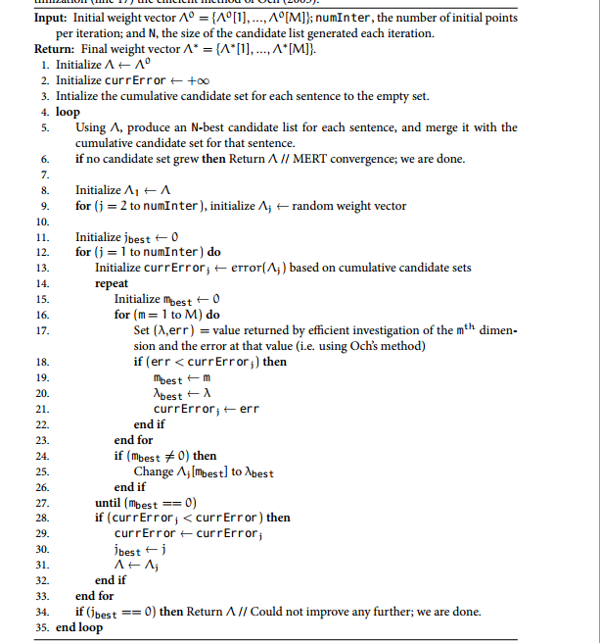
Lucene 检索-- MERT
MERT
2. parameter estimation using Och’s Method

Slide 11
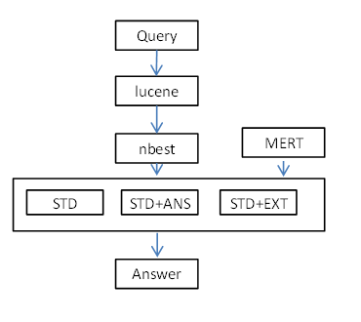
Lucene 检索-- MERT
MERT
3. lucene optimization with MERT

Slide 12
Reference
Lucene4.0 http://lucene.apache.org/core/4_0_0/core/org/apache/lucene/search/similarities/TFIDFSimilarity.html
F. Och. 2003. Minimum Error Rate Training in Statistical Machine Translation. In Proceedings of ACL, pages 160-167.
Zaidan. 2009. Z-MERT: A Fully Configurable Open Source Tool for Minimum Error Rate Training of Machine Translation Systems. The Prague Bulletin of Mathematical Linguistics, No. 91:79-88.

