Slide 1
WAV2VEC: Unsupervised Pre-Training for Speech Recoginiton
Wenwei Dong
Notes:
现阶段语音识别需要大量的语音转写文本来进行训练，很耗时，作者提出通过大量未标注语料进行预训练

Slide 2
WAV2VEC: a convolutional neural network that takes raw audio as input and computes a general representation that can be input to a speech recognition system.

Slide 3
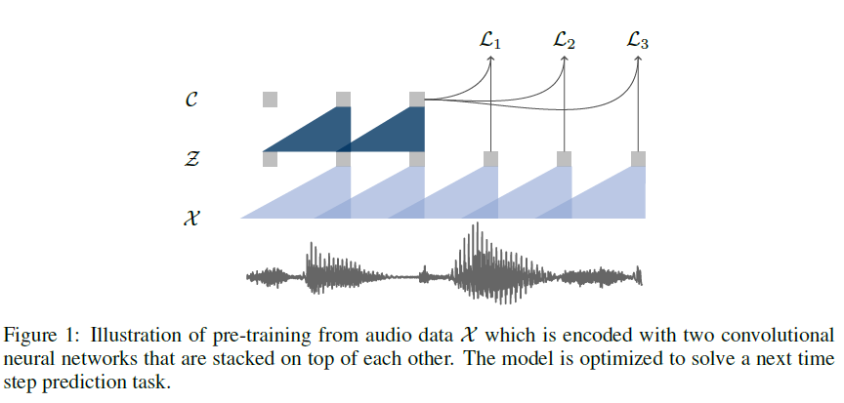

Slide 4
ASR dataset
TIMIT: standard train dev and tst
Train set: si284, dev set:nov93dev , testset: nov92
Pre-training
WSJ 81hours
Librispeech 80 hours clean data
Librispeech 960 hours

Slide 5
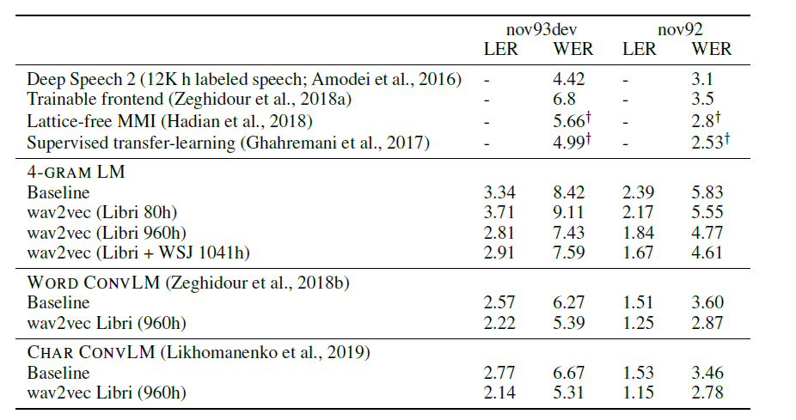

Slide 6
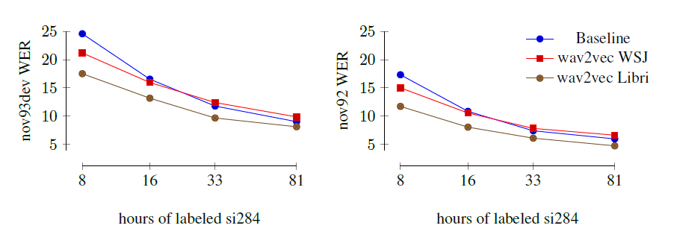

Slide 7
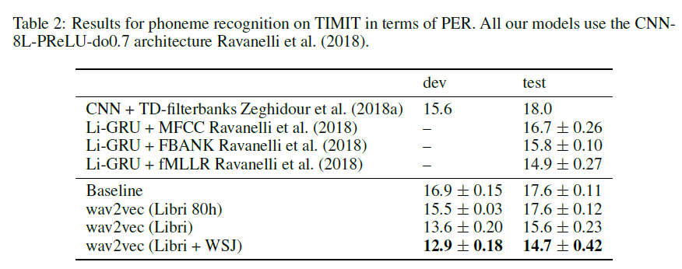

Slide 8
infoGan

Slide 10
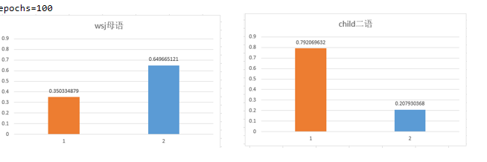
C=2
feature length =1s

Slide 11
C=10
Feature length = 1s

Slide 12
Test set :
1:1000 sentences of Chinese children speak English
model | corrcoef
GAN | 0.0314
infoGan+logistics regression | 0.1285
2:995 sentence Japanese speak English
Human-human | 0.5397
infoGan+logistics regression | 0.02

Slide 13
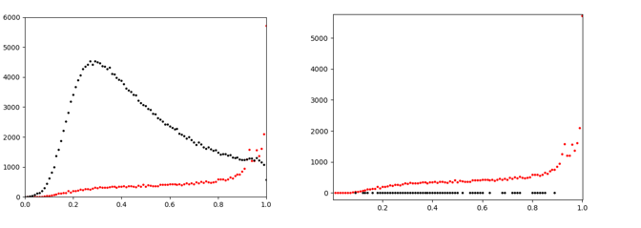
C=10
feature length =1 frame

Slide 14
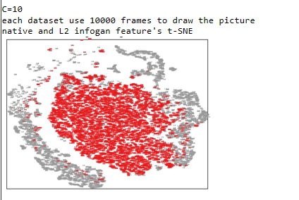
C=10
feature length =1 frame

Slide 15
model | corrcoef
Human-human | 0.5397
infoGan+logistic regression(C=10 mean) | 0.013
infoGan(C=2 mean) | 0.237
infoGan(C=2 mode) | 0.190

