Slide 1
representation learning approach for domain adaptation
Zhenyu Zhou
2023/05/26

Slide 2
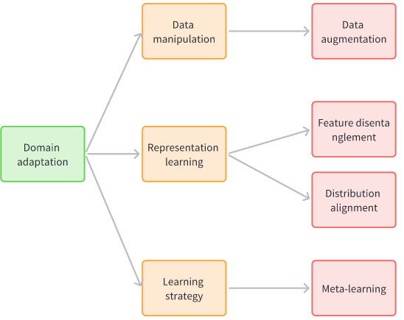
Domain-adaptation
Examples：
Data manipulation（Data augmentation）
Representation learning（Feature disentanglement，Distribution alignment）
learning strategy (meta-learning)

Slide 3
Representation learning
Method：
feature disentanglement method of adversarial learning (learning a domain-invariant feature)
distribution alignment of metric learning (reduce the difference between different domains)

Slide 4
Catalog
Domain-Adversarial Training of Neural Networks (arXiv 2015)
Deep CORAL: Correlation Alignment for Deep Domain Adaptation (arXiv 2016)
CLDA: Contrastive Learning for Semi-Supervised Domain Adaptation (NeurIPS 2021)
Class-Aware Distribution Alignment based Unsupervised Domain Adaptation for Speaker Verification (Interspeech 2022)
Meta Representation Learning Method for Robust Speaker Verification in Unseen Domains (Interspeech 2023)

Slide 5
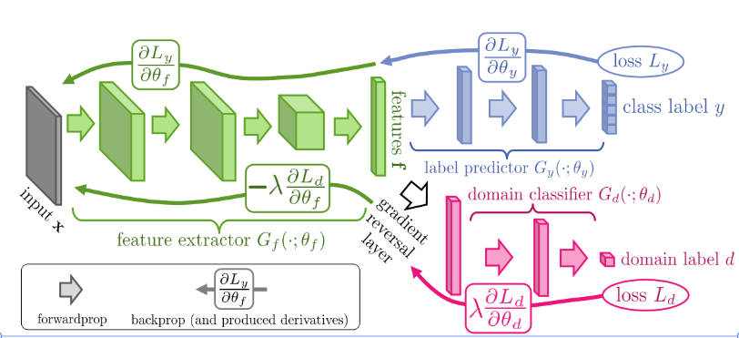
Domain-Adversarial Training of Neural Networks
Movitation：
discriminative for the main learning task
cannot discriminate between the training (source) and test (target) domains.
Network Architecture
Feature extractor
Gradient reversal layer(only works during backpropagation)
Domain classifier
label predictor

Slide 6
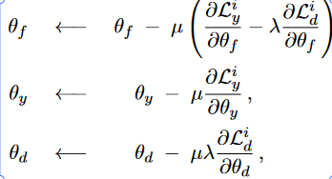
Domain-Adversarial Training of Neural Networks
parameter update & loss function:
label predictor loss
domian classifier loss

Slide 7
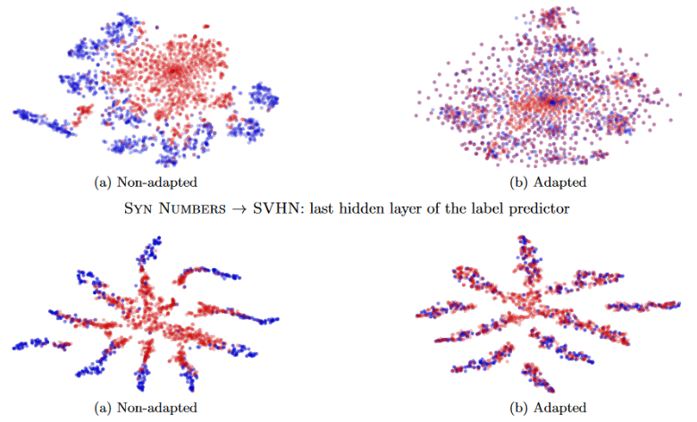
Domain-Adversarial Training of Neural Networks
Results & conclusion:
GRL will pass domain-related information to FE.
Domain-Adversarial Training can improve the generalization ability of the model obviously.

Slide 8
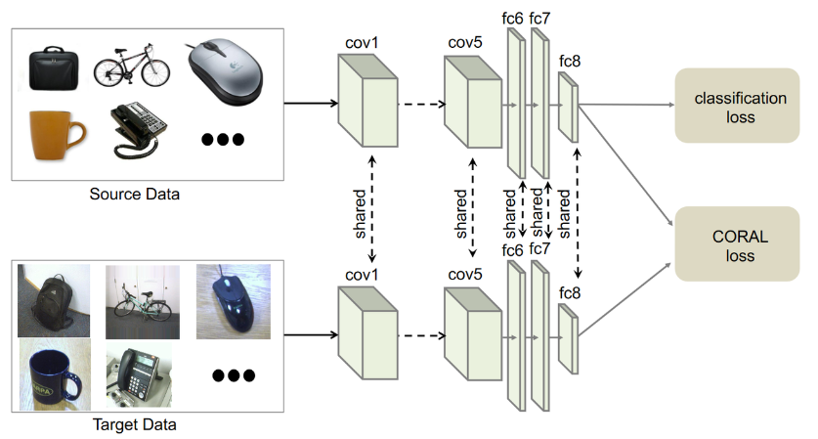
Deep CORAL: Correlation Alignment for Deep Domain Adaptation
Movitation：
aligns the second-order statistics of the source and target distributions
learn a nonlinear transformation that aligns correlations of layer activations in deep neural networks
Network Architecture
feature extractor(shared)
label classification

Slide 9
Deep CORAL: Correlation Alignment for Deep Domain Adaptation
parameter update & loss function:
Classification loss
CORAL loss
fail to consider latent speaker label

Slide 10
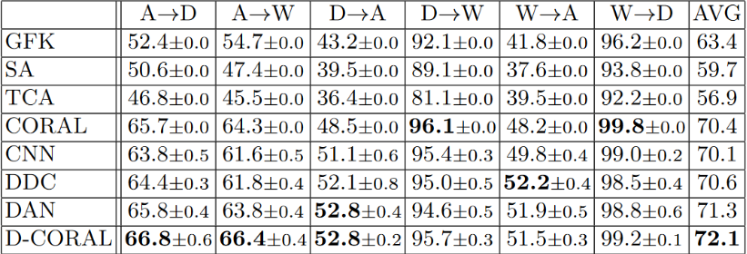
Deep CORAL: Correlation Alignment for Deep Domain Adaptation
Results & conclusion:
CORAL loss constrains the distance between source and target domain.
Deep CORAL work effectiveness

Slide 11
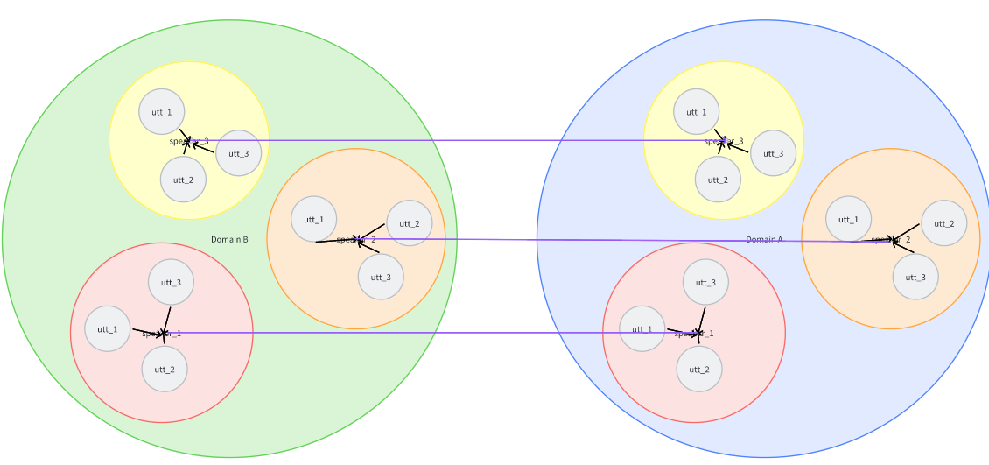
CLDA: Contrastive Learning for Semi-Supervised Domain Adaptation
Movitation：
intra-domain gap between the labeled and unlabeled target distributions
inter-domain gap between source distribution and unlabeled target distribution in SSDA
Method
class-wise contrastive learning（inter-domain gap）
instance-level contrastive alignment（intra-domain discrepancy）

Slide 12
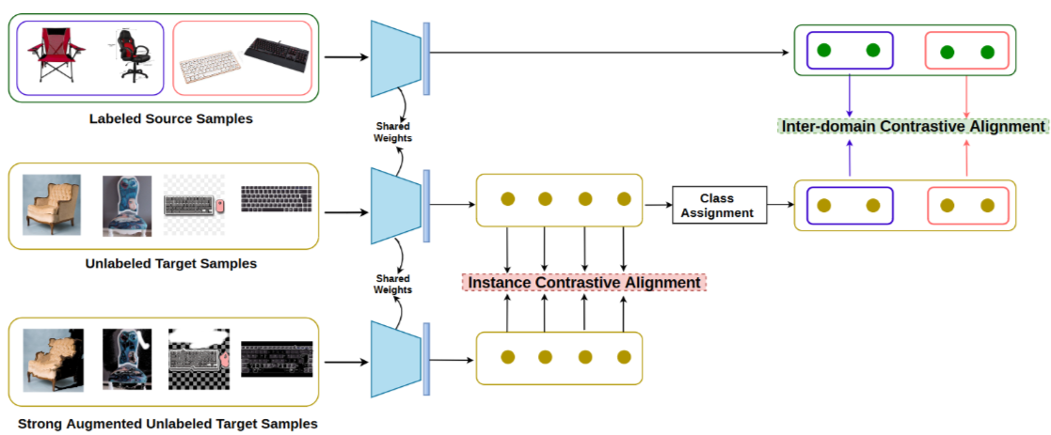
CLDA: Contrastive Learning for Semi-Supervised Domain Adaptation
Network Architecture :
Classification
Inter-Domain Alignment
Instance-Domain Alignment
parameter update & loss function:
Classification loss
Inter-Domain Alignment loss
Instance-Domain Alignment loss

Slide 13
CLDA: Contrastive Learning for Semi-Supervised Domain Adaptation
Results & conclusion:
CLDA method works effectively
The cross-domain sample labels should be consistent !

Slide 14
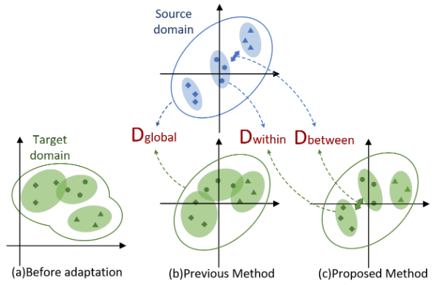
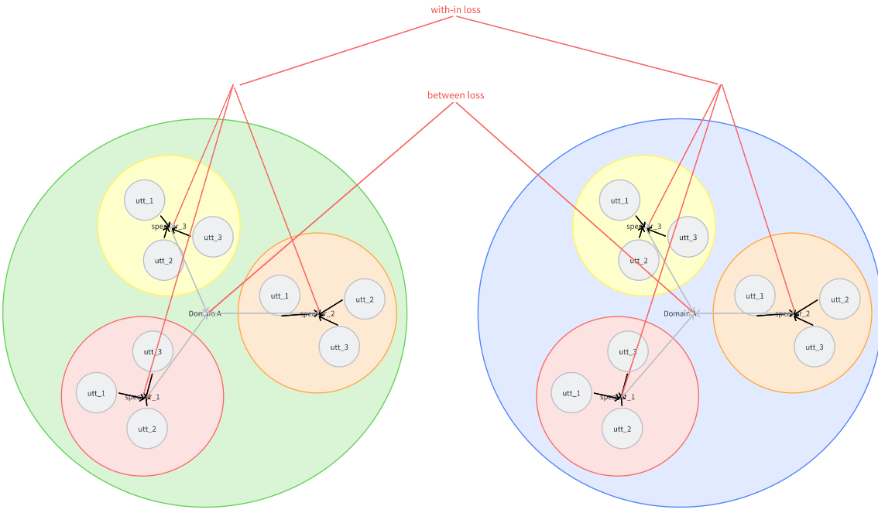
Class-Aware Distribution Alignment based Unsupervised Domain Adaptation for Speaker Verification
Motivation：
global distribution alignment strategies fail to consider latent speaker label information and can hardly guarantee the feature discriminative capability in target domain.
Method:
construct within-class and between-class pairs for source and target domains separately
transfer the within-class and between-class distribution information, estimated from the source domain to the target domain

Slide 15
Class-Aware Distribution Alignment based Unsupervised Domain Adaptation for Speaker Verification
Network Architecture :
Constructing within-class and between-class pairs
Feature extractor
Classification

Slide 16
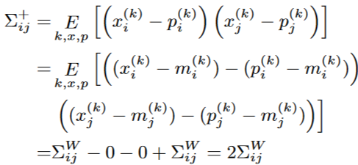
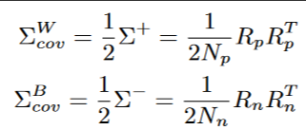
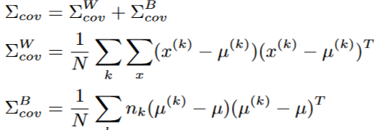
Class-Aware Distribution Alignment based Unsupervised Domain Adaptation for Speaker Verification
parameter update & loss function:
Classification loss
Within-class Alignment loss
Between-class Alignment loss

Slide 17
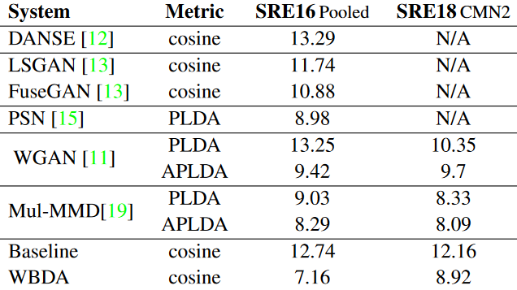
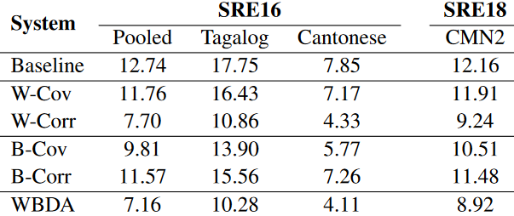
Class-Aware Distribution Alignment based Unsupervised Domain Adaptation for Speaker Verification
Results & conclusion:
WBDA is able to effectively estimate the within- and between-class distributions various.
A deep domain-invariant embedding architecture can be learned

Slide 18
Meta Representation Learning Method for Robust Speaker Verification in Unseen Domains
Movitation：
Multi-domain adaptation (cross-genre tests)
Good performance in unseen domains.
Method:
Domain Distribution Alignment Based on Metric Learning
Network Architecture :
Pre-tarin model
Domain balanced sampling
Feature extractor
Domain alignment module
Classifier

Slide 19
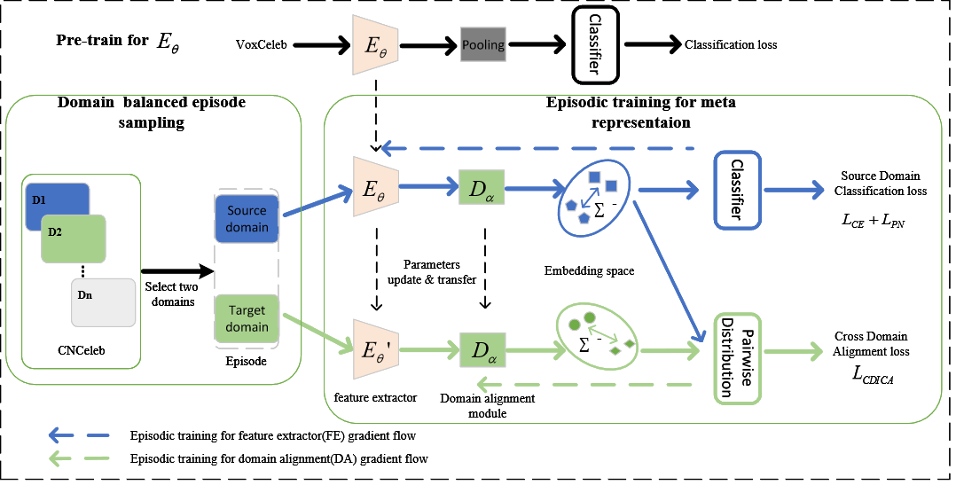
Meta Representation Learning Method for Robust Speaker Verification in Unseen Domains
Network Architecture :

Slide 20
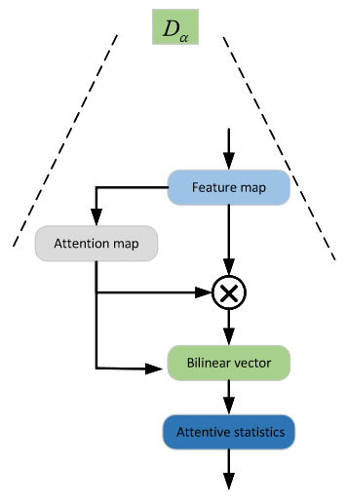
Meta Representation Learning Method for Robust Speaker Verification in Unseen Domains
parameter update & loss function:
Sampling : equal and balance
fix DA parameters, use source domain date calculate Loss(PN) & Loss(FE) to update FE
fix FE parameters, use target domain date calculate Loss(CDICA) to update DA

Slide 21
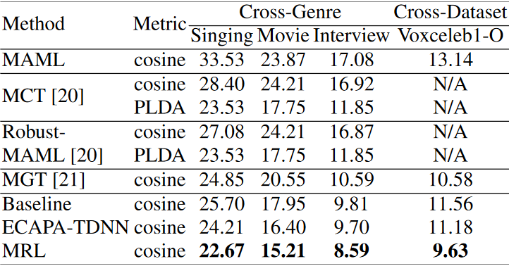
Meta Representation Learning Method for Robust Speaker Verification in Unseen Domains
Results & conclusion:
DA module alignment is effective
CDICA loss alignment perform better in Cross-Domain test

