Slide 1
Several Remarks on DNF
Dong Wang
2020/10/05

Slide 2
Link to shallow models

Slide 3
Normalization flow
An information preserved model
Information = Variation
How the variation is composed is another information
Preserved in the transform, lost in the code

Slide 4
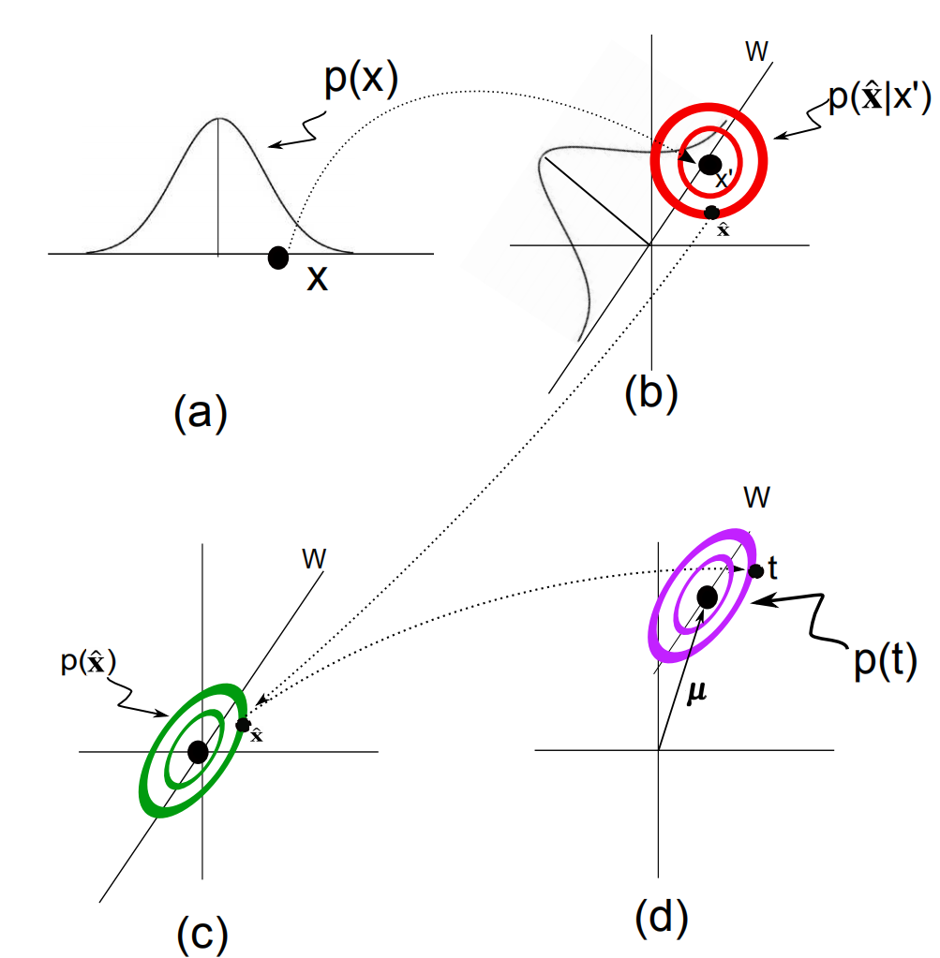
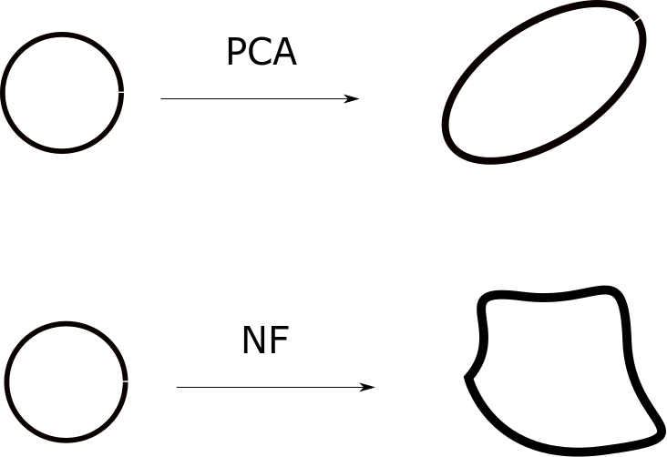
NF and PCA
PCA: Gaussian + linear + ML
NF: Gaussian + nonlinear + ML

Slide 5
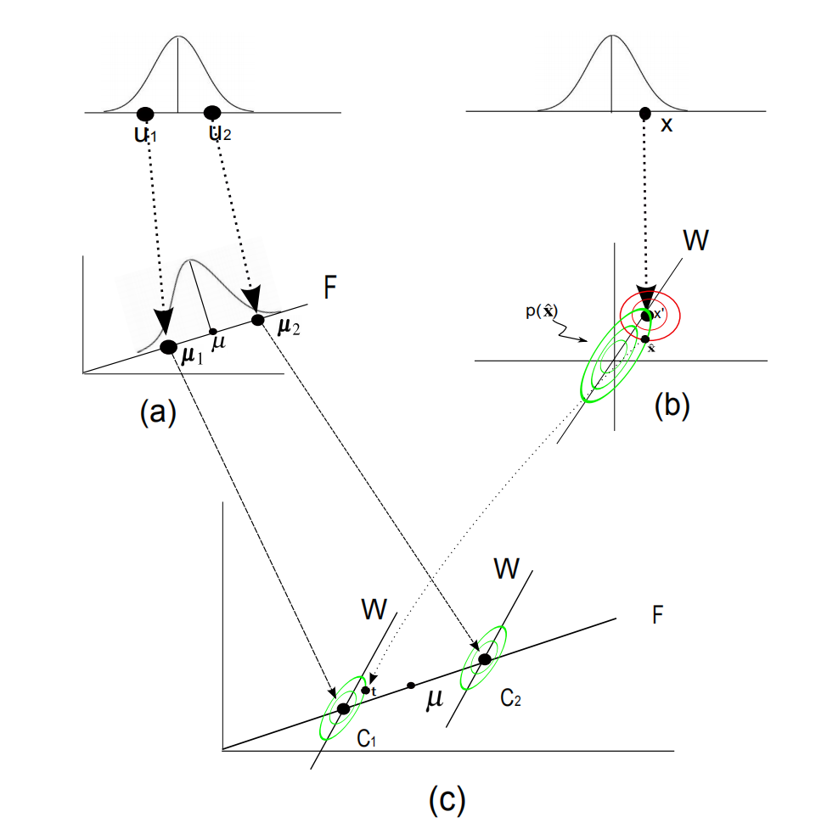
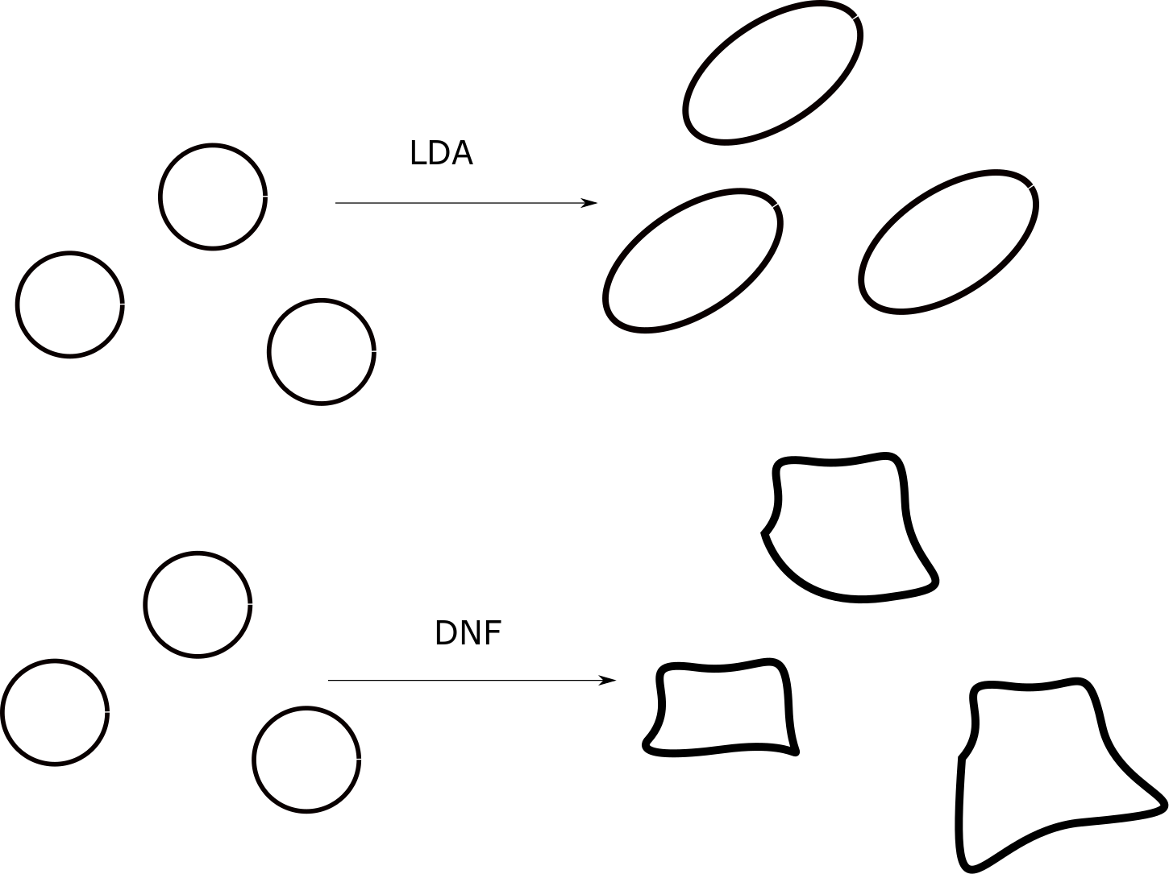
Discriminative Normalization Flow
LDA: Multi Gaussian + linear + ML
DNF: Multi Gaussian + nolinear + ML + nonhomogeneous

Slide 6
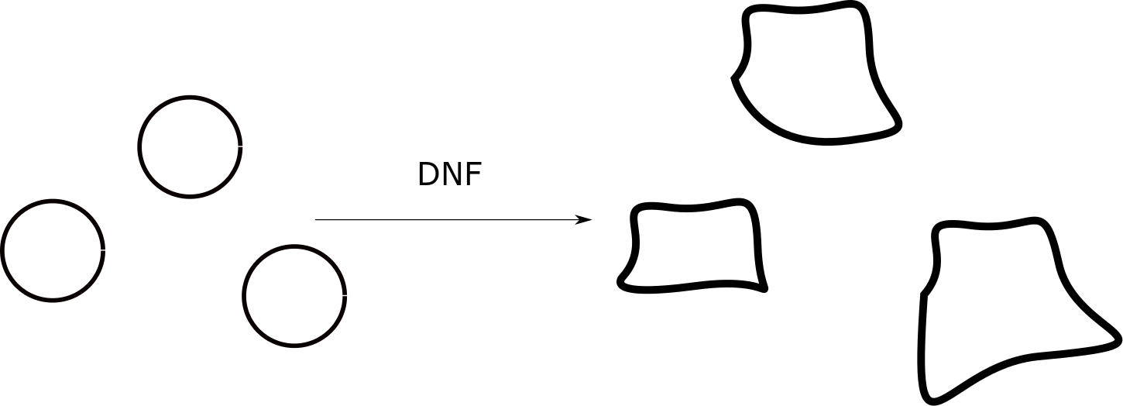
No proof for a perfect DNF
If we treat data without class info, then the NF can be well trained (even overfitting).
For DNF, there is no proof that the NF model can be well trained, i.e., fully represent the data distribution well keep the class information. NF is just a shared transform.

Slide 7
Information preservation

Slide 8
DNF information preservation
Preservation in the form of classification: if data can be well modeled by DNF, then classification based on x is equal to the classification based on z.
Compared to NF, this is an informational encoding.

Slide 9
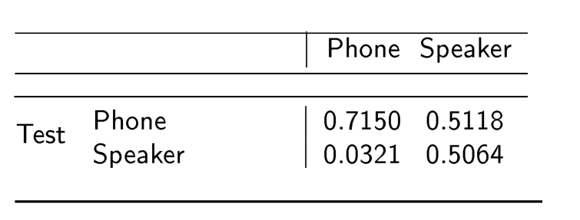
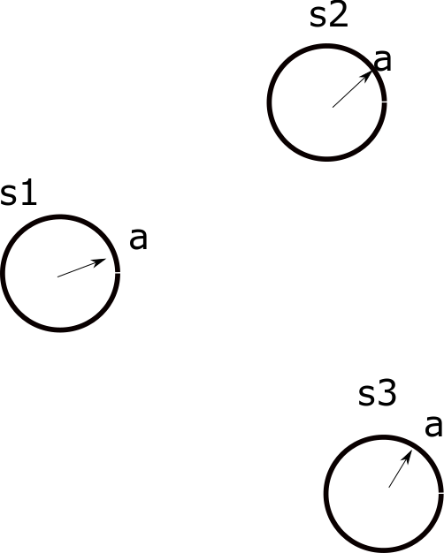
DNF information preservation
DNF encoding does not necessarily destruct other information.
DNF preserves all the information, however it arranges the information so that the target information can be represented by a simple model.

Slide 10
Dimension reduction

Slide 11
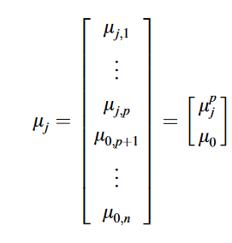
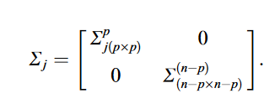
Dim-reduced LDA
In LDA, consider that only part of the dimensions are discriminative.
It turns out that the model is equivalent to dim-reduced LDA.
Kumar, N., Andreou, A.G., 1998. Heteroscedastic discriminant analysis and reduced rank hmms for improved speech recognition. Speech communication 26, 283–297.

Slide 12
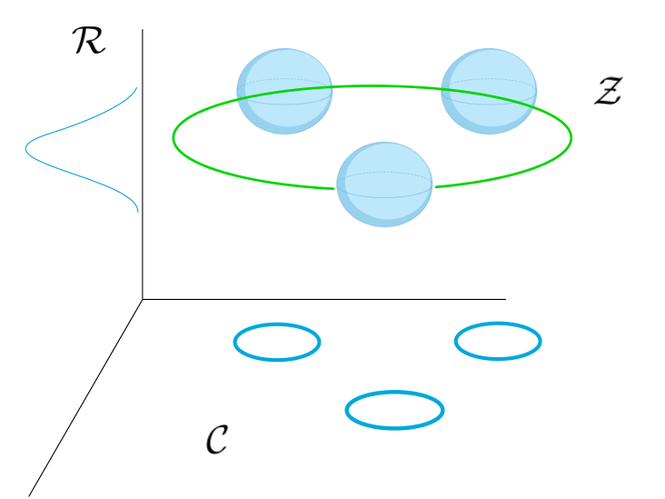
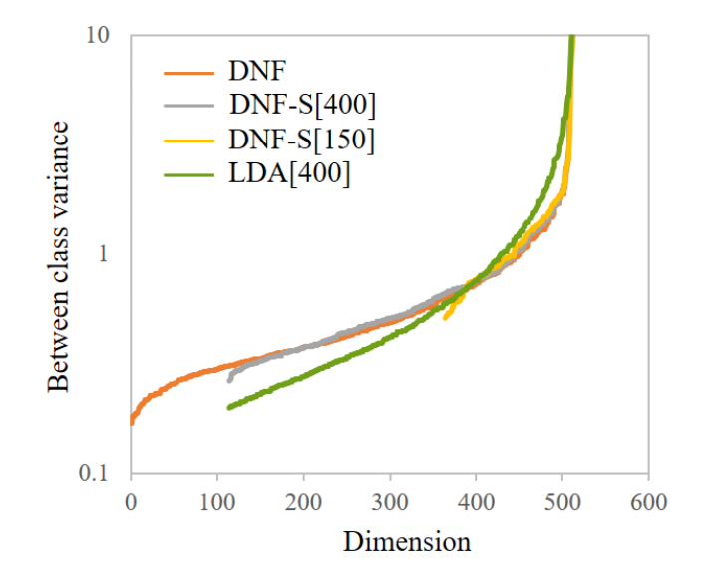
Subspace DNF
For DNF, constraint class means in the subspace, we obtain nonlinear dimension reduction.
Again, the dim of the subspace is not larger than the number of classes.
Note that subspace DNF is NOT necessarily better than the fullspace DNF.

Slide 13
Factorization
If we put classes of different types within their own subspace, then we can achieve nonlinear factorization.

Slide 14
Semi-supervised Learning

Slide 15
Deal with missed labels
Residual space are shared by all classes, which forms a partial NF.
For data without class labels, it can be trained like a NF.
Can be extended to multiple factors
A general framework that perform deep supervised+unsupervised learning.

Slide 16
Link to i-vector model

Slide 17
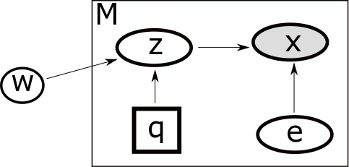
Review i-vector
x = T_{q}w_{s} + D_{q}e
A GMM mixture model in the latent space
ML training
Bayes inference

Slide 18
Latent i-vector
Directly map observation to latent space by NF
To make the latent space easier to be modeled.

Slide 19
NDA with Conditional NF: deep i-vector
Session variable

Slide 20
Direct model speaker distribution
Speaker variable

Slide 21
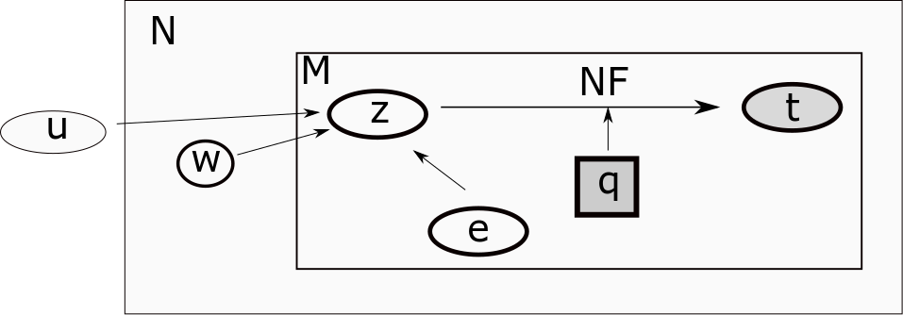
Better in the form of JFA

Slide 22
What you are doing
Speaker variable

Slide 23
Remarks
NF is a nonlinear extension of PCA
DNF is a nonlinear extension of LDA
DNF with a prior is NDA, which is an extension of PLDA
DNF remains all information, and make the information of the target factors in a simple form
DNF offers a full generative model that can deal with missing labels
NDA can be used to extend deep i-vector

