Slide 1
Knowledge distillation

Slide 2
Knowledge distillation for RNN-LM
《knowledge distillation for recurrent neural network language model with trust regularization》
RNN >> n-gram
In many applications, a large RNNLM or an ensemble of several RNNLMs is used.
Knowledge distillation & trust regularization
In a speech recognition N-best rescoring task, reduce the RNNLM
model size to 18.5% of the baseline with no degradation in WER
on WSJ
Notes:
出门问问ICASSP

Slide 3
Knowledge distillation
《Distilling the knowledge in a neural network》
背景
ensemble model is used to improve the performance in real applications.
Cumbersome & computationally expensive in deployment
思想
Transfer learning , distillation
Compression, project
实验设计
MNIST / ASR / JTF dataset
Notes:
Hinton在2015NIPS上关于知识蒸馏的一篇开山之作

Slide 4
思想&方法
思想
“蝴蝶以毛毛虫的形态吃树叶积攒能量逐渐成长，最后变换成蝴蝶这一终极形态完成繁殖。” ——《昆虫记》
蒸馏神经网络，就是从毛毛虫到蝴蝶
方法
将大模型学习的知识作为先验传递给小规模的神经网络，实际应用时部署小规模神经
网络。
Output of softmax
input of softmax
Knowledge distillation
Notes:
虽然是同一个个体，在面对不同环境和不同任务时，个体的形态非常不同。
就像神经网路学习某个问题，先要训练一个很大大的网络充分汲取数据特征信息和类间区别。或者网络足够大或者通过集成学习得到一个大网络
但实际应用中大网络很难部署

Slide 5
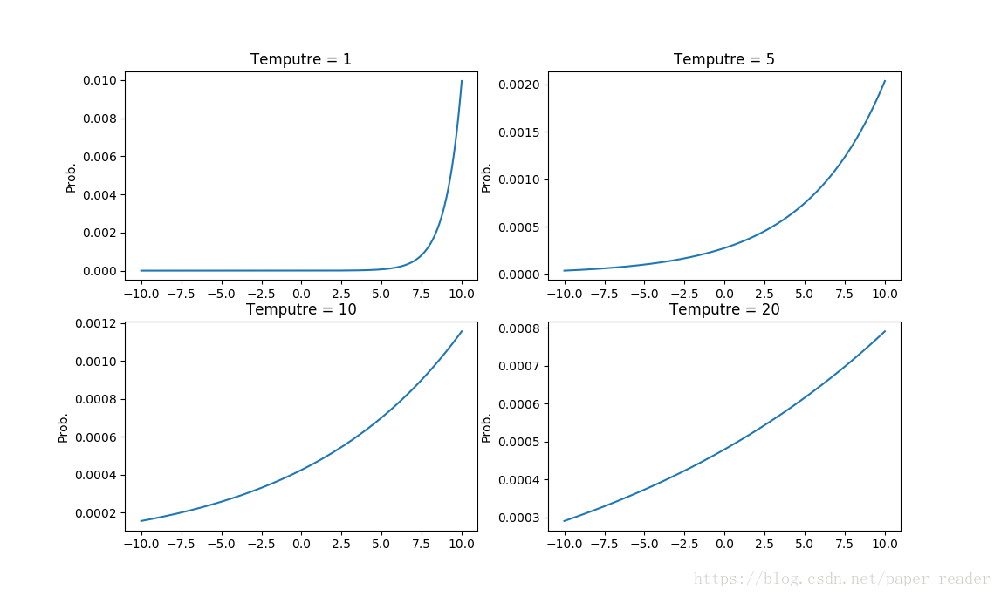
核心公式
$$q_{i}=\frac{exp⁡(z_{i}/T)}{\sum_{j}{exp⁡(z_{i}/T)}}$$
T：温度参数
Notes:
T：温度参数 为了对应于蒸馏这一概念

Slide 6
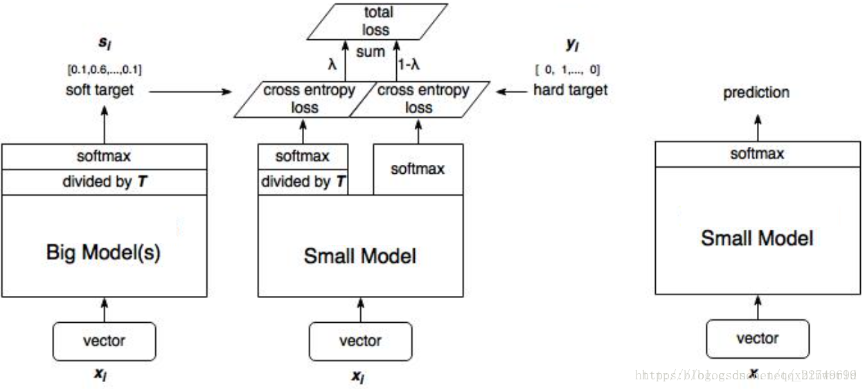
实验步骤
提升softmax的温度参数T，让大模型训练得到一个合适的“软目标”
采用同样的T训练小模型，使小模型匹配大模型的“软目标”
Notes:
Transfer data可以无标注
当transfer data部分或者全部有标注时，对两个目标函数设置权重系数

Slide 7
MNIST
 | NN configs | results | conclusion
baseline | Input-1200-1200-output Dropout & weight-constrains | 67 | Soft targets can transfer a great deal of knowledge to distilled model Bigger than 300-300, T>=8 fairly similar Input-30-30-output, T∈[2.5,4]，the best
SM model | Input-800-800-output No regularization | 146
Distill(T=20) | Input-800-800-output | 74
 | Experiment configs | results
Distill model | Omitting all examples 3 from transfer set(3 is never seen ) | 206 (133/1010 3s) | Fine-tune bias for 3
 |  | 109(14/1010 3s)
Distill model | Only containing 7 & 8 from training set(only 7 & 8 are saw) | 47.3% | Fine-tune bias for 7 & 8
 |  | 13.2%
The distilled model only makes 206 test errors of which 133 are on the 1010 threes in the test set. Most of the errors are caused by the fact that the learned bias for the 3 class is much too low. If the bias is increased by 3.5(which optimizes overall performance on the test set), the distilled model makes 109 errors of which 14 are on 3s. So with the right bias, the distilled model gets 98.6% of the test 3s correct dispite never having seen a 3 during training.
Notes:
Dropout can be viewed as a way of training an exponentially large ensemble of models that share weights.

Slide 8
ASR
Training set: 2000h
 | NN configs | Test Frame accuracy | WER
baseline | 8 layers 2560 nodes 14000 labels | 58.9% | 10.9%
10 * ensemble |  | 61.1% | 10.7%
Distilled single | T {1,2,5,10} Weight 0.5 for hard | 60.8% | 10.7%
Vary the set of data that each model sees, useless in ensemble
More than 80% of the improvement in frame classification accuracy achieved by using an ensemble of 10 models is
Transferred to the distilled model.

Slide 9
JFT
100 million labeled image with 15000 labels
Trained for 6 months using asynchronous stochastic gradient descent on a large number of cores
but only if a lot more cores are available
System | Conditional test accuracy | Test accuracy
Baseline | 43.1% | 25.0%
+61 specialist models | 45.9% | 26.1%
Specialist models
Trained on examples from a very confusable subset of classes (eg: different types of mushroom)
Class is smaller by combining all of the classes it doesn’t care about into a dustbin class
Initialized with weight of generalist model
½ from special subset, ½ sampled from the remainder of the training set
Notes:
Learning specialist models that each focus on a different confusable subset of the classes can reduce the total amount of computation required to learn an ensemble.

Slide 10
ASR
System & training set | Train frame accuracy | Test frame accuracy
Baseline(100% of training set) | 63.4% | 58.9%
Baseline(3% of training set) | 67.3% | 44.5%
Soft targets(3% of training set) | 65.4% | 57.0%
Conclusion:
soft targets allow a new model to generalize well from only 3% of the training set.

Slide 11
谢谢
https://blog.csdn.net/xbinworld/article/details/83063726
https://blog.csdn.net/haoji007/article/details/76777430
https://www.zhihu.com/question/50519680/answer/136406661
https://www.cnblogs.com/jins-note/p/9679450.html

