Slide 1
实习生汇报
——北邮 张安迪

Slide 2
Tasks
Deep learning by Bengio
Tensorflow web docs
One tensorflow example
Jeff Dean’s talk at NIPS

Slide 3
Basic Theories of Deep Learning
Feed forward networks
Goal: approximate some function $f^{∗}$
classfier: y=$f^{∗}(x)$
In general: y=$f(x;θ)$

Slide 4
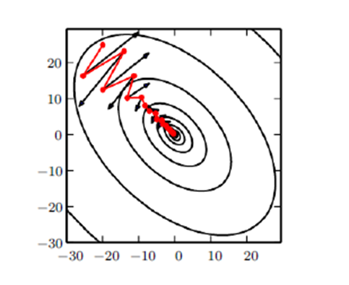
Basic Theories of Deep Learning
Feed forward networks
Training：gradient descent
Stochastic gradient descent --momentum
Differences between linear model：cost function non-convex
solution: initialize w and b to small random values
Cost function: cross-entropy $H\left(p,q\right)=−\sum_{x}{p\left(x\right)\log{q(x)}}$
negative log-likelihood

Slide 5
Basic Theories of Deep Learning
Feed forward networks
Cost function: cross-entropy $H\left(p,q\right)=−\sum_{x}{p\left(x\right)\log{q\left(x\right)+αΩ(θ)}}$
Regularization:
$L^{2}$ $Ω(θ)$ = ${\frac{1}{2} \left\|w\right\|}_{2}^{2}=$ $\sqrt{\sum_{i}{{(x_{i})}^{2}}}$
$L^{1}$ $Ω(θ)$ = ${\left\|w\right\|}_{1}$ = $\sum_{i}{\left|w_{i}\right|}$
Data augmentation—fake data,noise
Early stopping

Slide 6
Basic Theories of Deep Learning
Feed forward networks
Hidden units: RELU $h=g(W^{T}x+b)$
$g\left(z\right)=max⁡\{0,z\}$

Slide 7
Basic Theories of Deep Learning
Feed forward networks
Output units:
Linear units for gaussian output distributions
Sigmoid units for bernoulli output distributions
Softmax units for multinoulli output distributions

Slide 8
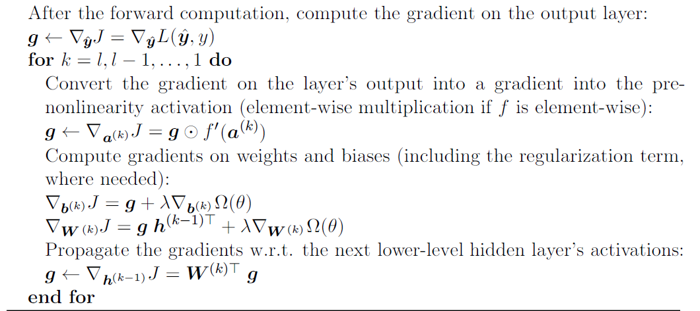
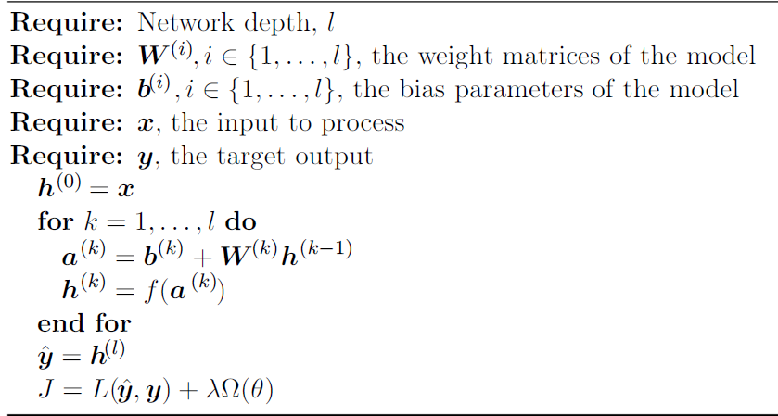
Basic Theories of Deep Learning
Feed forward networks
back-propagation: a method for computing the gradient

Slide 9
Basic Theories of Deep Learning
2. Convolutional networks
--neural networks that use convolution instead of general matrix multiplication
$s\left(t\right)=\left(x∗w\right)\left(t\right)=\sum_{a=−∞}^{∞}{x\left(a\right)w(t−a)}$
$S\left(i,j\right)=\left(I∗K\right)\left(i,j\right)=\sum_{m}{\sum_{n}{I\left(i+m,j+m\right)K(m,n)}}$

Slide 10
Basic Theories of Deep Learning
Convolutional networks
ways to improve a machine learning system
Sparse interactions
Parameter sharing
Equivariant representation

Slide 11
Basic Theories of Deep Learning
Convolutional networks
Pooling
Make the representation invariant to small translation of input when we care more about whether a feature exists than where it is.
Improve the computational efficiency of the network(also memory requirement, etc.)
Essential for handling inputs of varying size
adjust stride

Slide 12
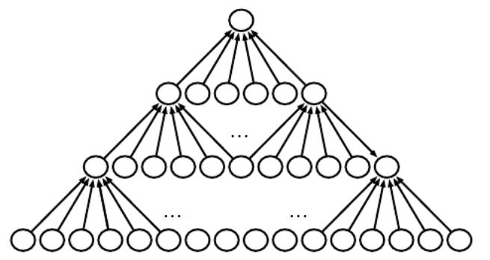
Basic Theories of Deep Learning
Convolutional networks
problem: network size shrinks too fast
solution: zero padding

Slide 13
Basic Theories of Deep Learning
Recurrent networks(RNN)
--a family of networks for processing sequential data
$h^{(t)}=f(h^{\left(t−1\right)},x^{(t)};θ)$
--with same f and same $θ$at every time step t

Slide 14
Basic Theories of Deep Learning
Recurrent networks
Produce an output at each time step and have recurrent connections between hidden units
Produce an output at each time step and have recurrent connections from output to hidden units
--teacher forcing, lack info of the past; easy to train
Produce one output and have recurrent connections between hidden units

Slide 15
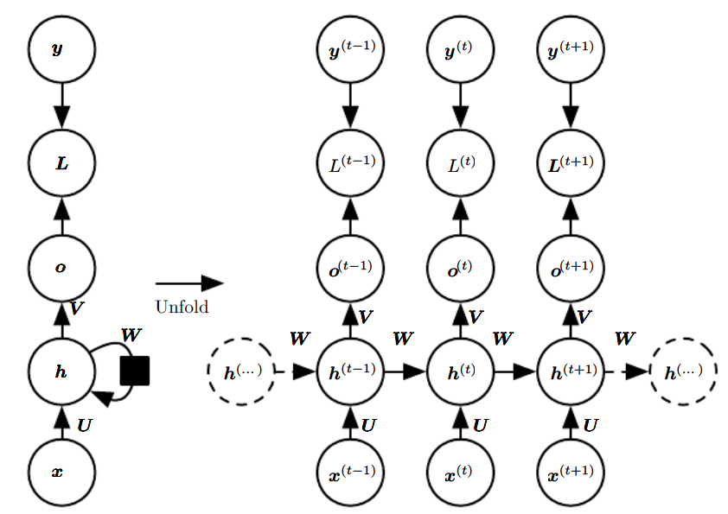
Basic Theories of Deep Learning
Recurrent networks
$$a^{(t)}=b+Wh^{(t−1)}+Ux^{(t)}$$
$$h^{(t)}=sigmoid(a^{(t)})$$
$$o^{\left(t\right)}=c+Vh^{(t)}$$
$${\hat{y}}^{(t)}=softmax(o^{(t)})$$

Slide 16
Basic Theories of Deep Learning
Recurrent networks
BPTT

Slide 17
Basic Theories of Deep Learning
Recurrent networks
Useful models
(1)Encoder-decoder sequence-to-sequence architectures
Input -> encoder -> context C -> decoder -> output
(2) Recursive neural network
depth reduce from $τ to O (logτ)$
(3)Long short-term memory
gated RNN

Slide 18
II. A simple model using Tensorflow
Convolution network
MNIST
Handwritten digits
Training set – 60000
Test set -- 10000

Slide 19
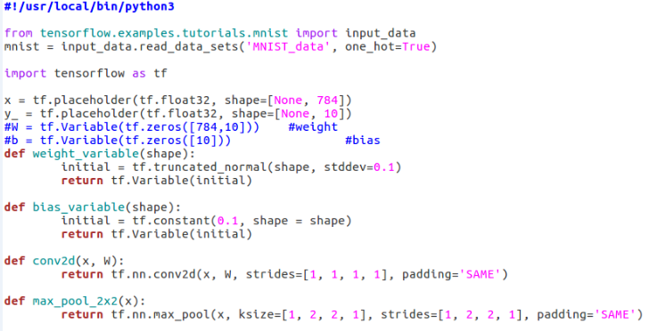
II. A simple model using Tensorflow

Slide 20
II. A simple model using Tensorflow

Slide 21
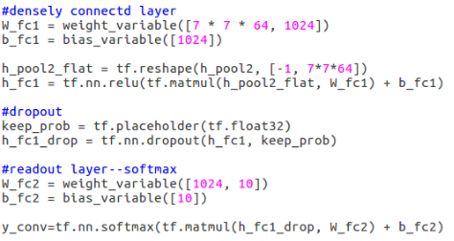
II. A simple model using Tensorflow

Slide 22
II. A simple model using Tensorflow

Slide 23
II. A simple model using Tensorflow

Slide 24
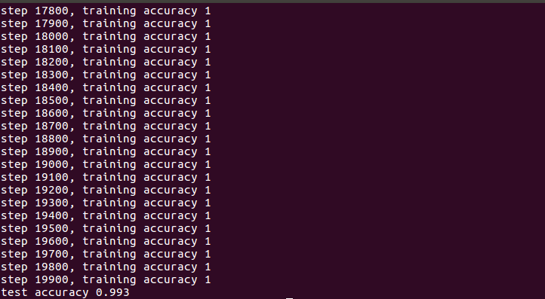
II. A simple model using Tensorflow

