Slide 1
Why LSTM
张东旭

Slide 2
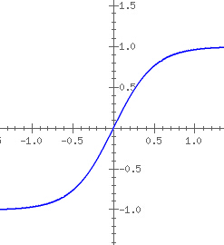
RNN
$s\left(t\right)=f(Ws\left(t−1\right)+x(t))$
f()--Nonlinearity function; s(t) hidden state(one dimemsion);
x(t) input(one dimension)
If W>1/f’(0), then there will be two attractors where $s=f\left(ws\right),$ ($s≠0$)
Store is accomplished by keeping a large input x.
Larger w, more robustness against noise.

Slide 3
BPTT
$s\left(t\right)=f(Wf(Wf(Wf(Ws\left(t−3\right)+x(t−3))+x(t−2))+x(t−1))+x(t))$
$$\frac{∂C_{t}}{∂x(t−3)}=\frac{∂C}{∂s(t−1)}\frac{∂s(t−1)}{∂s(t−2)}\frac{∂s(t−2)}{∂x(t−3)}$$
$$\frac{∂C_{t}}{∂W}=\sum_{i=1}^{2}{\frac{∂C}{∂S(t−1)}\frac{∂s(t−1)}{∂s(t−i)}\frac{∂s(t−i)}{∂W}}$$

Slide 4
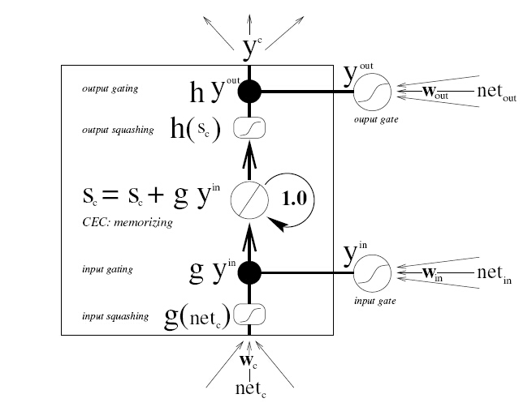
LSTM
The LSTM algorithm overcomes this problem by enforceing non-decaying error flow “back into time”. (CECs, constant error carrousels)
$$s\left(t\right)=s\left(t−1\right)+y^{in}∙x(t)$$

Slide 5
Gers F. Long short-term memory in recurrent neural networks[J]. Lausanne, EPFL, 2001, 2366.
Bengio Y, Simard P, Frasconi P. Learning long-term dependencies with gradient descent is difficult[J]. Neural Networks, IEEE Transactions on, 1994, 5(2): 157-166.
THANK YOU

