Slide 1
Open Information Extraction using Wikipedia

Slide 2
Information Extraction(IE)
distill semantic relations from natural- language text
supervised learning of relation-specific examples and limited training data
How to handle unbounded number of relations found on the Web(Open IE)?

Slide 3
Open IE
Definition:
A function map a document d to a set of triplets, {⟨arg₁, rel, arg₂⟩}.
args are noun phrases, rel is a textual fragment indicating an implicit, semantic relation between the two noun phrases
Difference with KB:
1.unbounded number of relation VS pre-defined relation(hand-crafted patterns)
2.self-supervised learning VS supervised learning
3. without VS with annotated training examples

Slide 4
Novel Form for Learning
WOE: Wikipedia-based Open Extractor
self-supervised learning of unlexicalized extractors
using heuristic matches between Wikipedia infobox attribute values and corresponding sentences to construct training data
features:
POS tag features: quick
dependency-parse features: good performance

Slide 5
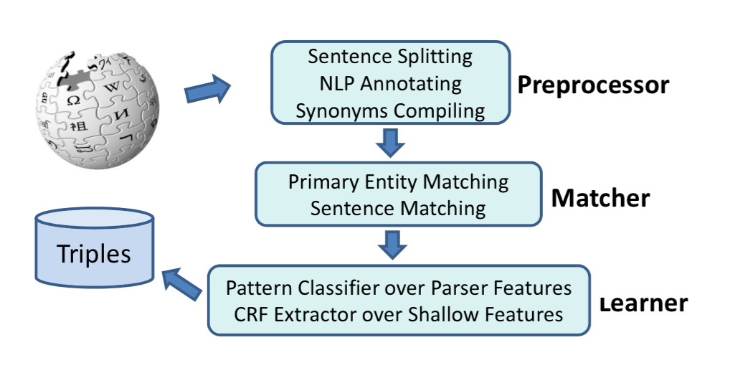
Architecture of WOE

Slide 6
Preprocessor
Sentence Splitting: using OpenNLP
NLP Annotation:
1.POS tags and NP-chunk annotations
2.uses the Stanford Parser to create a dependency parse, treat hyperlinked anchor text as a single token(improve parsing perfomance)
Compiling Synonyms: multiple name for an entity, using redirection pages and backward links

Slide 7
Matcher
constructs training data for the learner component
heuristically matching attribute-value pairs from Wikipedia articles containing infoboxes with corresponding sentences in the article
E.g.
⟨established, 1891⟩
“The university was founded in 1891 by ...”
Matching Primary Entities
Matching Sentences

Slide 8
Learning Extractors
Extraction with Parser Features
Extraction with POS

Slide 9
Extraction with Parser Features
1. Shortest Dependency Path as Relation
E.g.
“Dan was not born in Berkeley.”
Parsing Dependencies of Stanford Parser:
nsubjpass(born-4, Dan-1)
auxpass(born-4, was-2)
neg(born-4, not-3)

Slide 10
Extraction with Parser Features
E.g. (continue)
binary dependence from dependent token to the governor token.
dependencies=>directed graph: ⟨V, E⟩, V is token, E is dependency.
corePath between token “Dan” and “Berkeley”
expandPath:

Slide 11
Extraction with Parser Features
2. Building a Database of Patterns(DB_{p})
using matcher selected sentence to generate corePaths between the tokens denoting the subject and the infobox attribute value
generalized-corePaths: combat data sparsity and improve learning performance and eliminate distinctions which are irrelevant for recognizing (domain-independent) relations.

Slide 12
Extraction with Parser Features
3. Learning a Pattern Classifier
Then traverses the triple’s expandPath to output the final expression ⟨Dan, wasNotBornIn, Berkeley⟩

Slide 13
Extraction with POS
using matcher selected sentence, label the subject and infobox attribute value as arg₁ and arg₂ to serve as the ends of a linear CRF chain, Tokens involved in the expandPath are labeled as rel
a two-order CRF chain model
features include POS-tags, regular expressions and conjunctions of features occurring in adjacent positions

