Slide 1
Zero-resource Language verification and identification
2019/5/29
于嘉威

Slide 2
语音中包含很多信息
Notes:
语音里包含很多信息

Slide 3
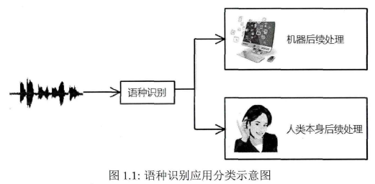
什么是自动语种识别？
通过计算机识别给定语音是什么语言
多语言环境下的自动语音识别
自动转接
国家安全
Notes:
语音里包含很多信息

Slide 4
分类
基于文本的语种识别
基于语音的语种识别
language identification
language verification
Open set
Close set
Language recognition

Slide 5
Language identification
?
Which language is this?
?
?
?

Slide 6
Language verification
Is this Chinese?
?

Slide 7
Open set v.s. zero-resource
Open set将训练集之外的数据都标识为unknown，识别目标还是以训练集中的语种为主。
Zero-resource 则是类似于说话人识别的过程，训练集之外的数据都有自己所属的国别标签，训练目标是识别这些集外的语种。

Slide 8
zero-resource language verification
Enrollment Phase
Enrollment speech for each language
Model for each language
English
Feature extraction
Model training
Model training
English
Chinese
Chinese
Verification Phase
Feature extraction
Verification
decision
Verification
decision
Accepted!
Claimed identity: Chinese

Slide 9
Why we do this？
对于一些低资源的语种，如果有这样一个语种识别系统，我们便可以在有丰富资源的语言上训练好一个语种识别模型，然后让用户注册几句话，以后我们便可以识别这一低资源的语言。
Notes:
更符合实际需求

Slide 10
Experimental set-up
Data set: AP18-OLR
training set: 94285 utterances,10 languages
enroll and test set: 8 languages different from the training set, total 1264 utterances(enroll 80 and 160)
Baseline test set: 10 languages, 1000 utterances and 2000 utterances
Model
I-vector
D-vector

Slide 11
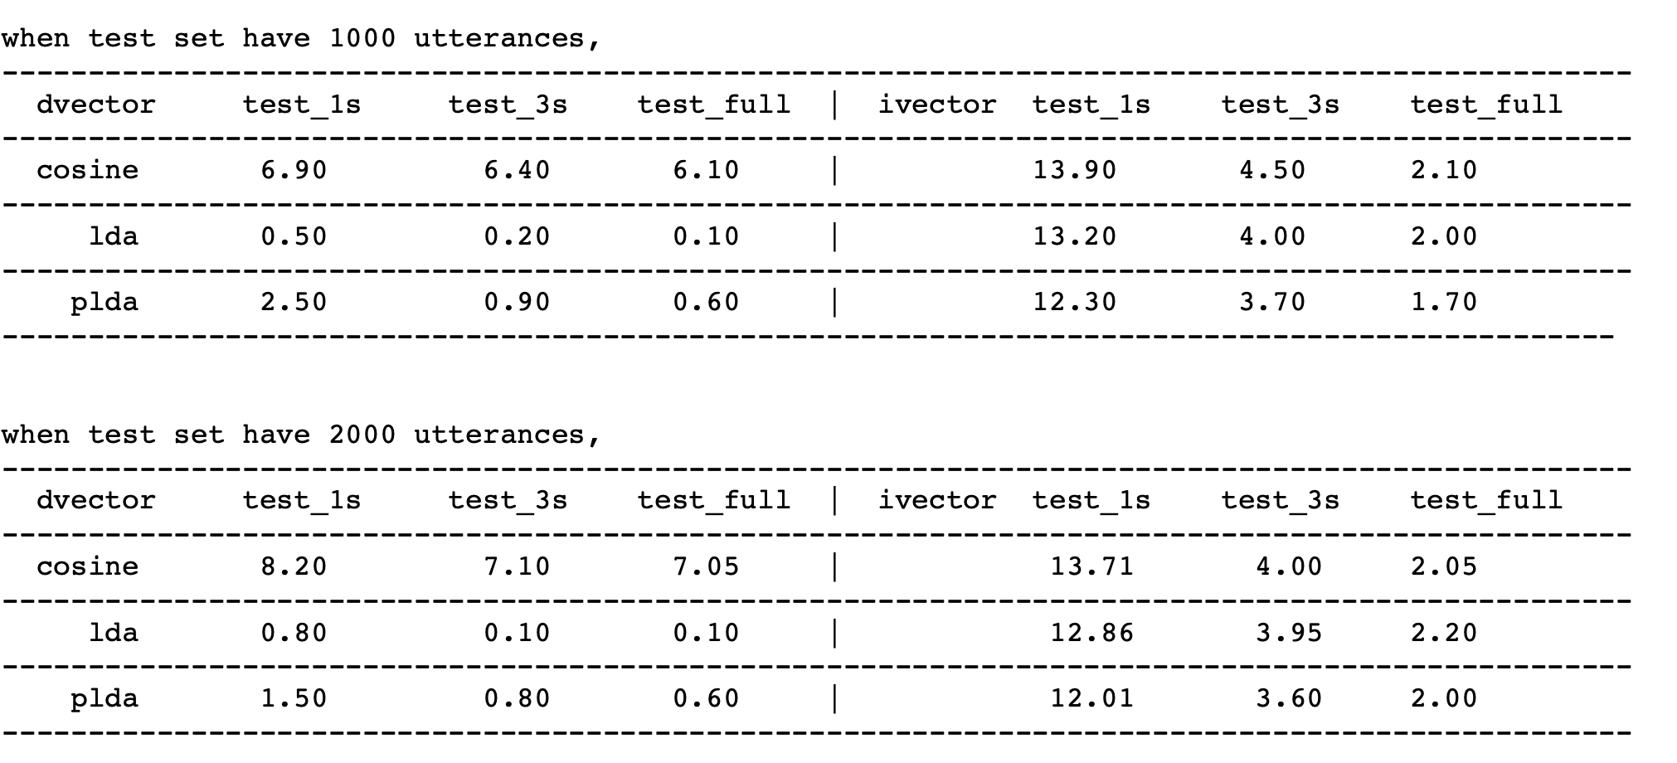
Results
Baseline EER

Slide 12
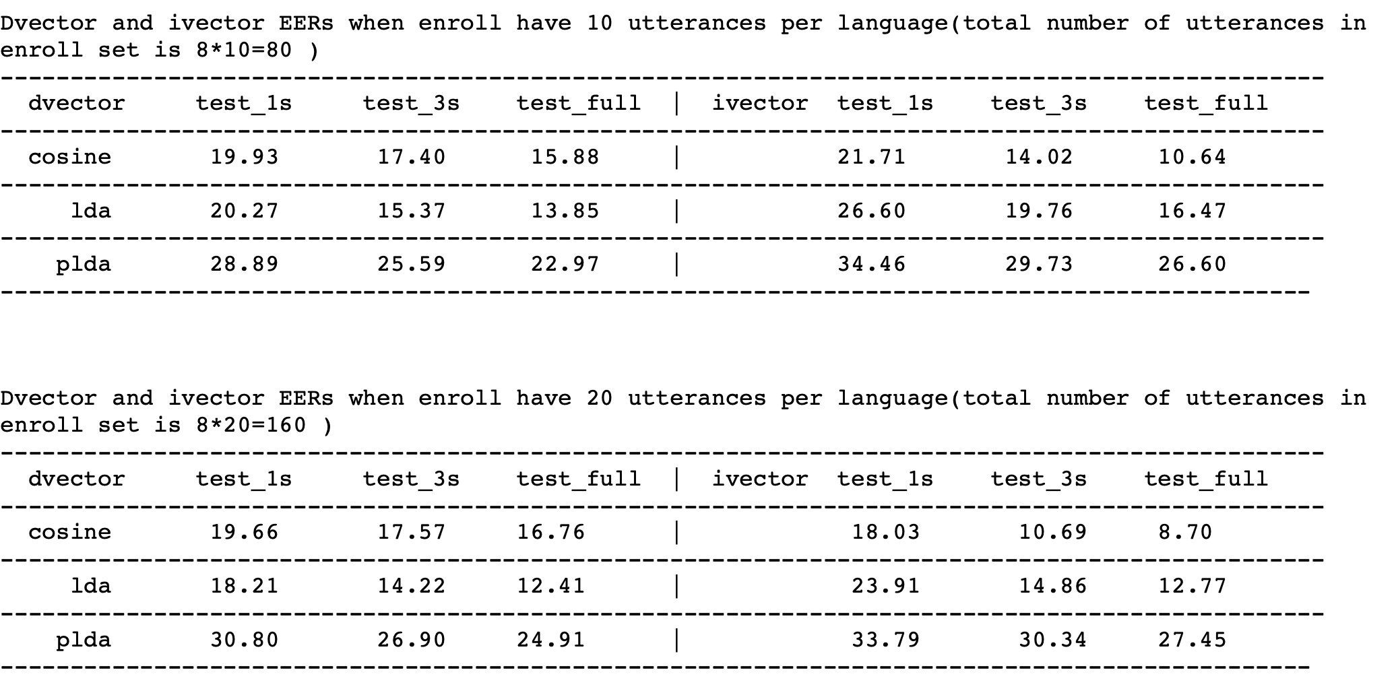
Results
Zero-resource

