Slide 1
Discriminative Scoring for Speaker Recognition Based on I-vectors
Jun Wang
7/07/2014

Slide 2
outline
Introduction
Background theory
Motivation of NN approach
NN-based discriminative model
Experiments
Conclusions

Slide 3
Introduction
  Background
    i-vector: the most popular approach to speaker verification. [N. Dehak, 2011]
    PLDA: Probabilistic linear discriminant analysis, achieve state-of-the-art performance.[S. Ioffe, 2006][C. S. Greenberg, 2013]
  Motivation
    limitations of PLDA:
      assumptions on data distributions.
      not directly optimized with respect to speaker verification task.
    the difference between discriminative model and generative model.
  Our approach
    NN-based ( neural-network-based ) discriminative scoring approach.

Slide 4

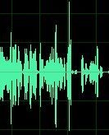


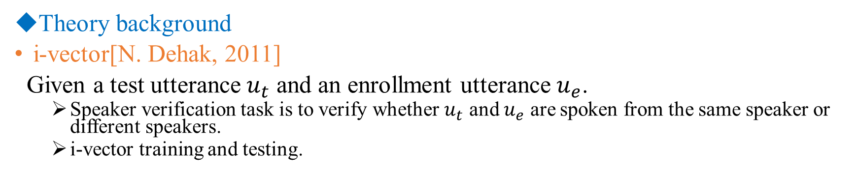


Theory background
i-vector[N. Dehak, 2011]
Given a test utterance $u_{t}$ and an enrollment utterance $u_{e}$.
  Speaker verification task is to verify whether $u_{t}$ and $u_{e}$ are spoken from the same speaker or different speakers.
  i-vector training and testing.
UBM
Universal background model
In training procedure
training corpora
T
Total variability matrix
$$u_{t}$$
Mel frequency cepstral coefficient
i-vector
UBM
T
MFCC
Baum-Welch statistics
$$ω_{t}$$
In testing procedure
Decision method
$$u_{e}$$
UBM
T
MFCC
Baum-Welch statistics
$$ω_{e}$$

Slide 5
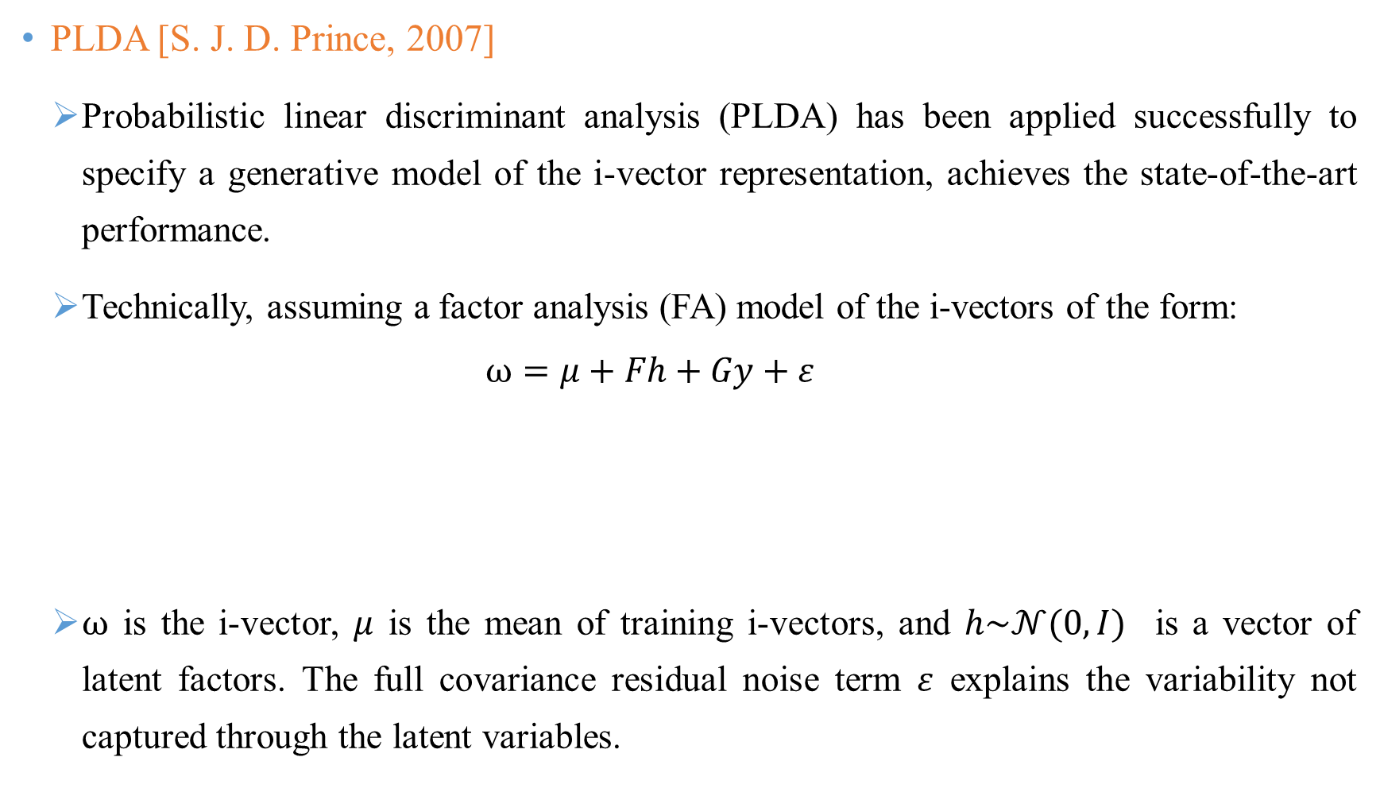
PLDA [S. J. D. Prince, 2007]
  Probabilistic linear discriminant analysis (PLDA) has been applied successfully to specify a generative model of the i-vector representation, achieves the state-of-the-art performance.
  Technically, assuming a factor analysis (FA) model of the i-vectors of the form:
  $$ω=μ+Fh+Gy+ε$$
  $ω$ is the i-vector, $μ$ is the mean of training i-vectors, and $h\sim 𝒩(0,I)$ is a vector of latent factors. The full covariance residual noise term $ε$ explains the variability not captured through the latent variables.
Speaker dependent part
Session dependent part

Slide 6
Comparison between generative model and discriminative model
    The generative model and discriminative model are seen as complementary.
 | generative model | discriminative model
1 | modeling observations drawn from a probability density function | do not need to model the distribution of the observed variables
2 | can simulate values of any variable in the model | allows only sampling of the target variables conditional on the observed quantities
3 | can generally express more complex relationships between the observed and target variables. | provides a model only for the target variable conditional on the observed variables
4 | PLDA | NN

Slide 7
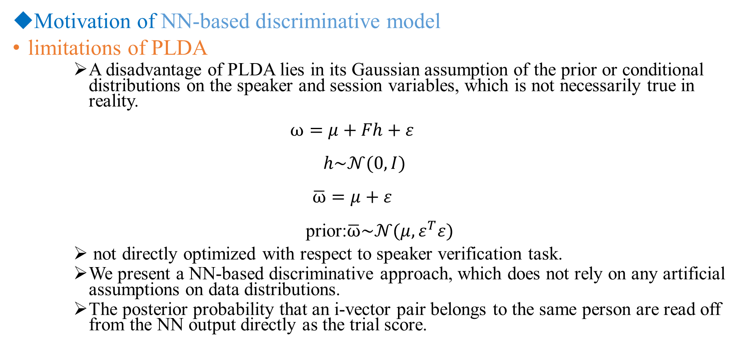
Motivation of NN-based discriminative model
limitations of PLDA
    A disadvantage of PLDA lies in its Gaussian assumption of the prior or conditional distributions on the speaker and session variables, which is not necessarily true in reality.
  $$ω=μ+Fh+ε$$
  $$h\sim 𝒩(0,I)$$
  $$\overline{ω}=μ+ε$$
  prior:$\overline{ω}\sim 𝒩(μ,ε^{T}ε)$
    not directly optimized with respect to speaker verification task.
    We present a NN-based discriminative approach, which does not rely on any artificial assumptions on data distributions.
    The posterior probability that an i-vector pair belongs to the same person are read off from the NN output directly as the trial score.

Slide 8
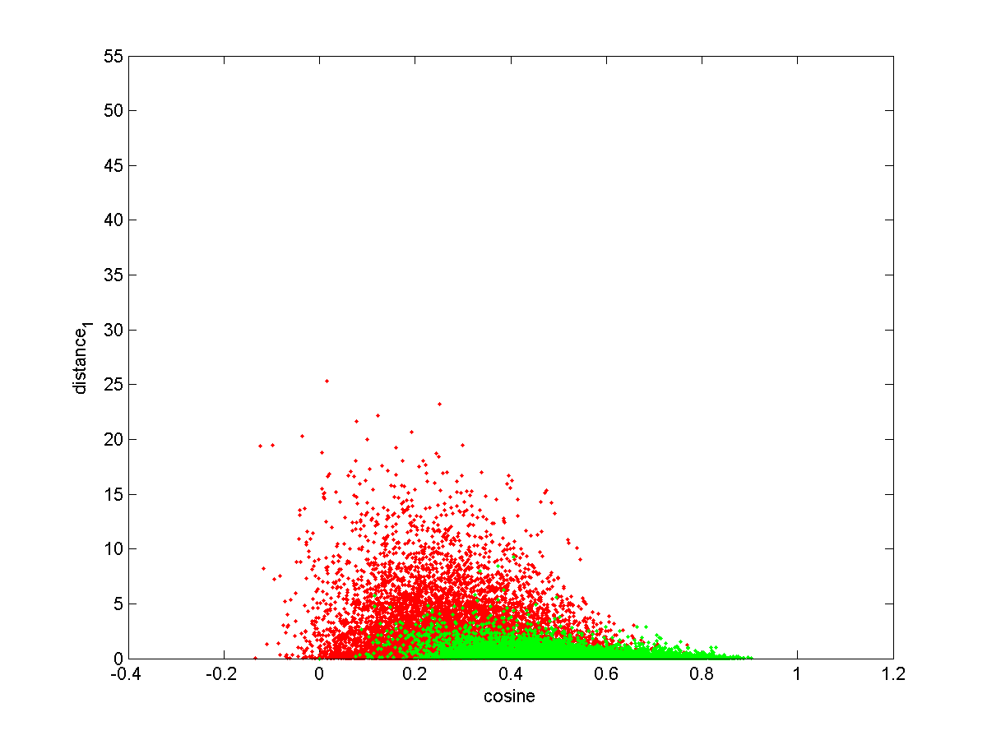
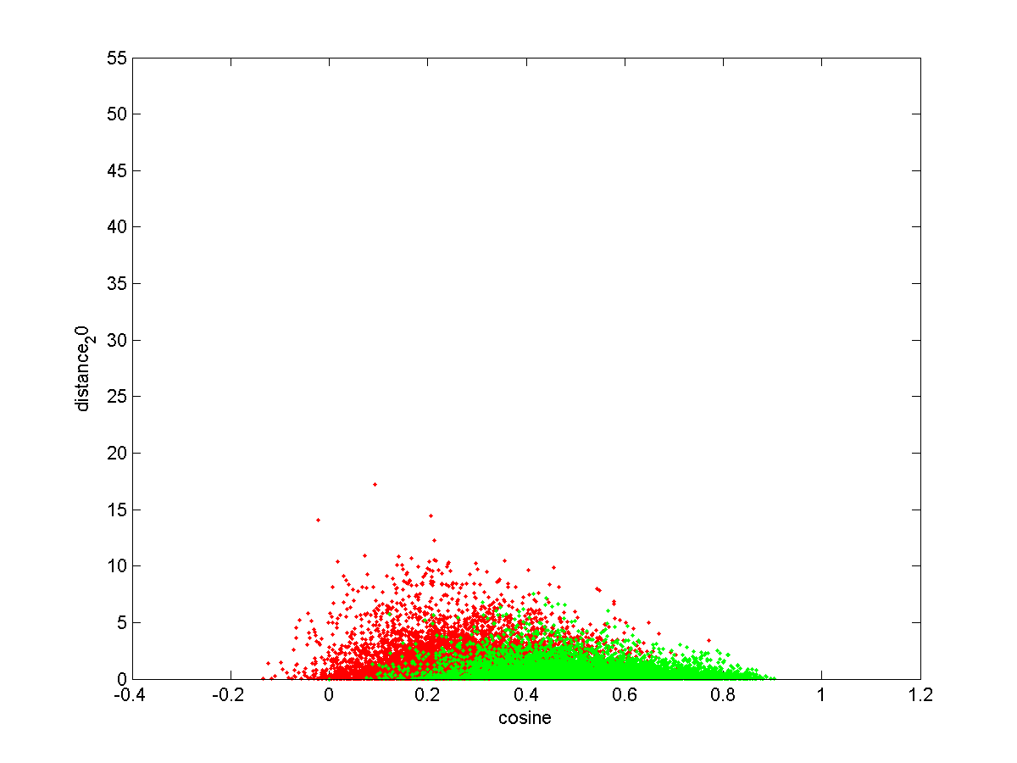

    the amplitudes of i-vector also contain speaker information

Slide 9
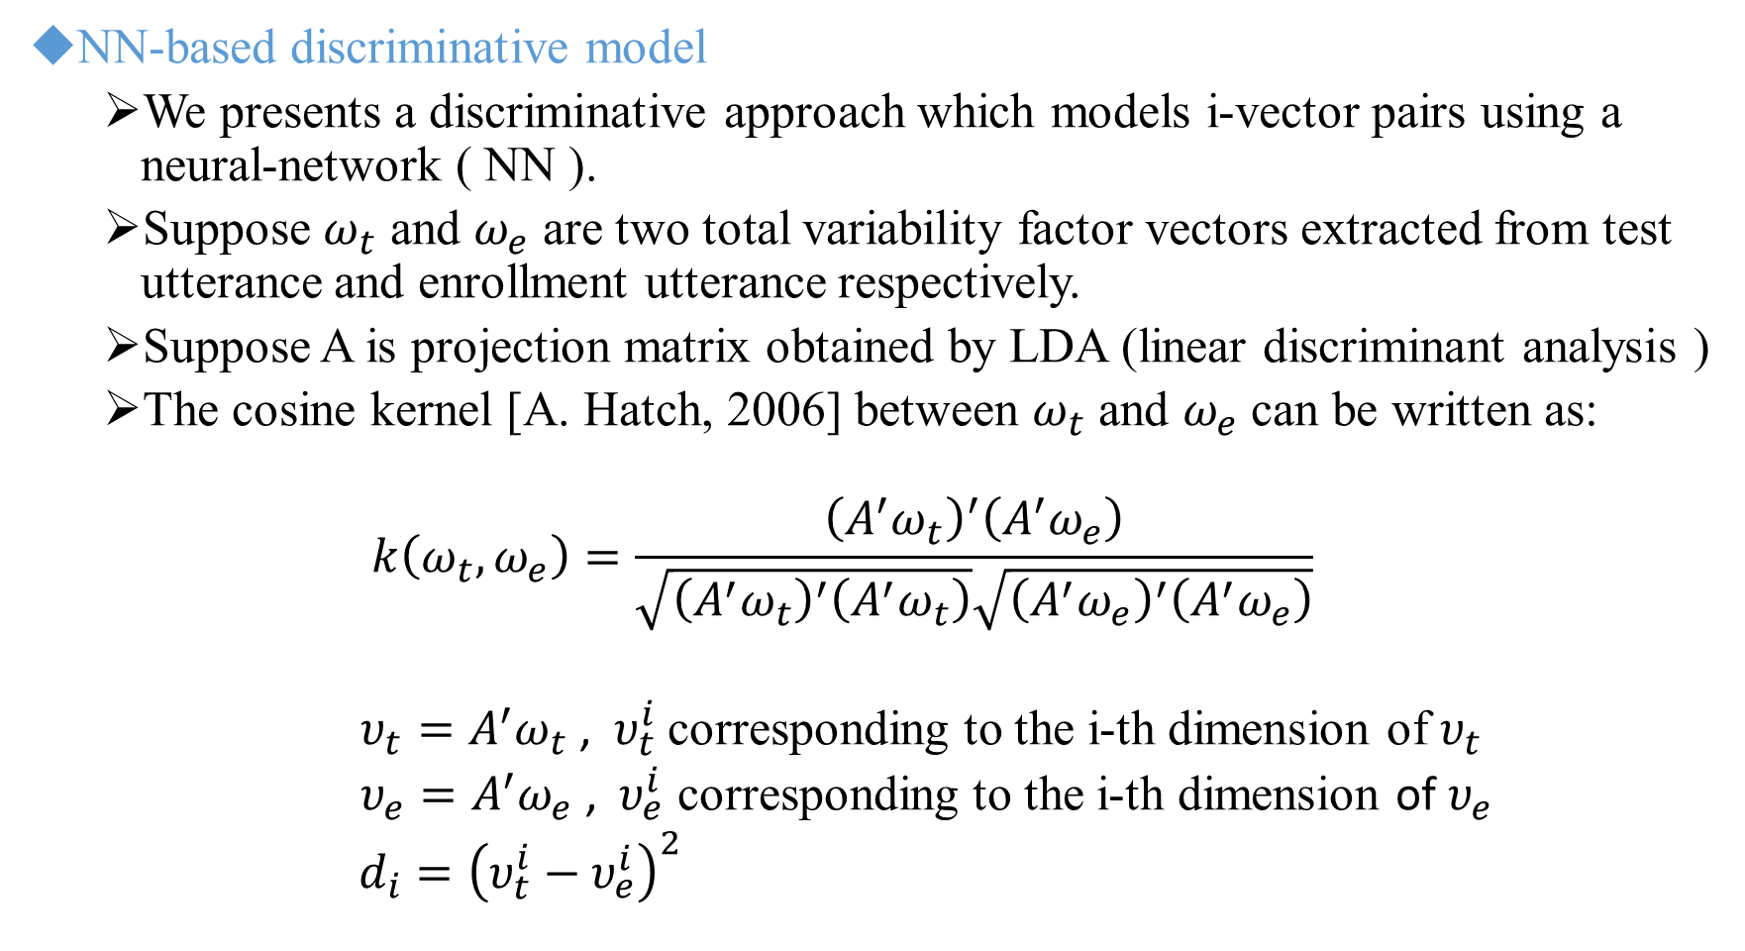
NN-based discriminative model
  We presents a discriminative approach which models i-vector pairs using a neural-network ( NN ).
  Suppose $ω_{t}$ and $ω_{e}$ are two total variability factor vectors extracted from test utterance and enrollment utterance respectively.
  Suppose A is projection matrix obtained by LDA (linear discriminant analysis )
  The cosine kernel [A. Hatch, 2006] between $ω_{t}$ and $ω_{e}$ can be written as:
  $$k\left(ω_{t},ω_{e}\right)=\frac{{\left(A^{′}ω_{t}\right)}^{′}\left(A^{′}ω_{e}\right)}{\sqrt{{\left({A^{′}ω}_{t}\right)}^{′}\left(A^{′}ω_{t}\right)}\sqrt{{\left(A^{′}ω_{e}\right)}^{′}\left(A^{′}ω_{e}\right)}}$$
  $υ_{t}=A^{′}ω_{t}$ , $υ_{t}^{i}$ corresponding to the i-th dimension of $υ_{t}$
  $υ_{e}=A^{′}ω_{e}$ , $υ_{e}^{i}$ corresponding to the i-th dimension of $υ_{e}$
  $d_{i}={\left(υ_{t}^{i}−υ_{e}^{i}\right)}^{2}$

Slide 10




NN structure
input layer
hidden layer
output layer
$$k\left(ω_{t},ω_{e}\right)$$
$$d_{1}$$
from the same speaker
how to determine the best N ?
$$d_{2}$$
from the different speaker
$$d_{N}$$
  $layerdims="--layerdims N+1:200:200:2“.
  $epochs="--epochs 5:5:10“.
  training data: 32500 pairs of utterances, 16250 for same speaker pairs.

Slide 11
Accuracy on training set
  Different epochs.
  Using all frames for epoch frames, about 32500 frames for each epoch training.

Slide 12
NN testing
input layer
hidden layer
output layer
$$k\left(ω_{t},ω_{e}\right)$$
$$d_{1}$$
trial score
$$d_{2}$$
$$d_{N}$$
  The posterior probability that an i-vector pair belongs to the same person are read off from the NN output directly as the trial score.

Slide 13

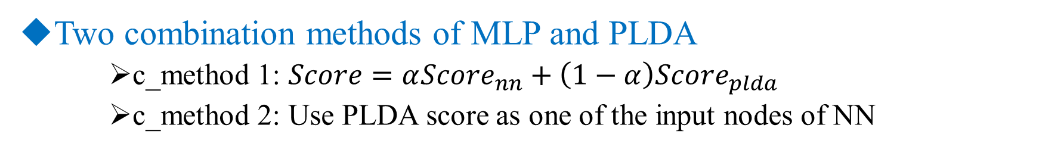



Two combination methods of MLP and PLDA
    c_method 1: $Score=α{Score}_{nn}+\left(1−α\right){Score}_{plda}$
    c_method 2: Use PLDA score as one of the input nodes of NN
input layer
hidden layer
output layer
$$k\left(ω_{t},ω_{e}\right)$$
$${Score}_{plda}$$
from the same speaker
$$d_{1}$$
from the different speaker
$$d_{N}$$

Slide 14
Experiment
  Database
    Development database
        Fisher English part 1 and 2 as development dataset
        contains 7196 females (12837 utterances).
    We also define a cross-validation dataset
        select 100 speakers from SRE08 to build a cross-validation dataset
        contains about 3000 trials with all 8 common evaluation conditions.

Slide 15
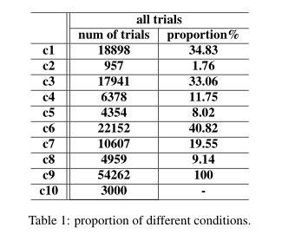
  Test database
      NIST 2008 speaker recognition evaluation (SRE 2008) [NIST, 2008]:
      core test of SRE 2008 is named short2-short3
      contains 1997 females and 59343 trials.(including the cross-validation dataset)
      at least 2 minutes of speech for a given speaker
      8 common evaluation conditions and define an all trials condition

Slide 16
Experiments setup
  Configurations of i-vector
      NIST 2008 speaker recognition evaluation (SRE 2008)
      sampling rate of the audio signals is 8 kHz and the sample size is 16 bits
      20-dimensional mel-frequency cepstral coefficients, delta and delta-delta
      2048 Gaussian Mixtures
      400 total factors
      150-dimensional LDA, 400-dimensional PLDA
  MLP setup
      2 hidden layers with 200 nodes
      Output layer: 2 nodes, 1 0 for the same speakers, 0 1 for the imposters
      training data: 32500 pairs of speakers
      epoch frames: using all training data in each epoch
      input layer: number of nodes dependents on the number of LDA dimensions we choose

Slide 17
  Experiment results
  NN test on the cross-validation dataset
    N=10 will get the best result

Slide 18
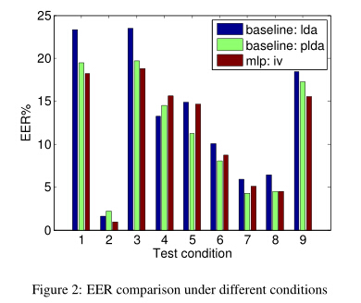
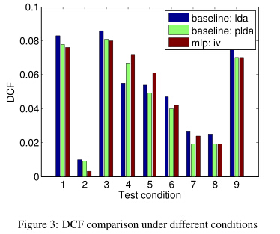
  NN test under different conditions

Slide 19
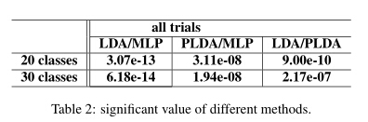
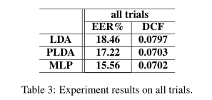
  NN test on all trials

Slide 20
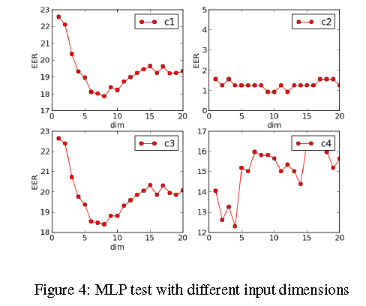
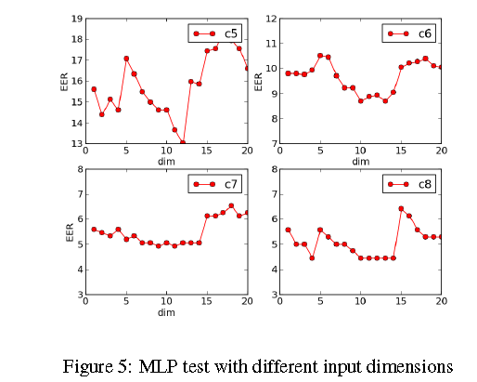
  NN test with different input dimensions (from N=1 to N=20)

Slide 21
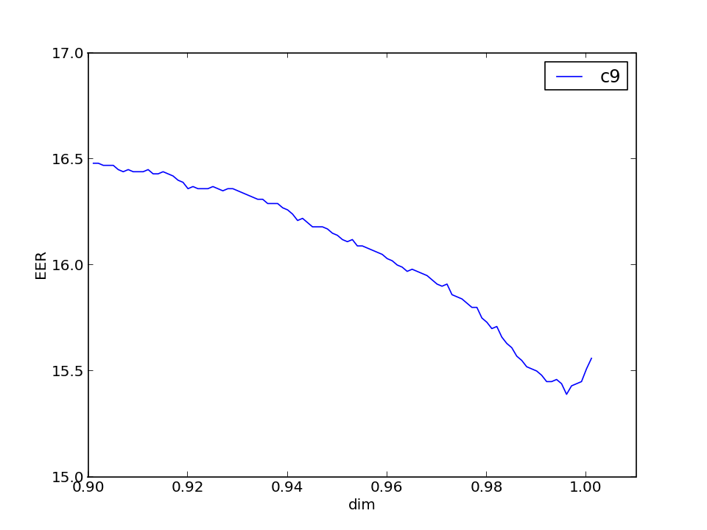
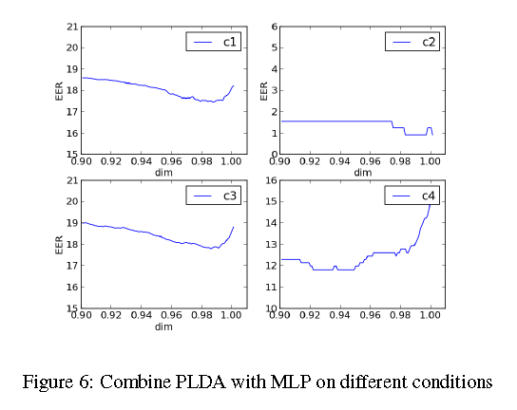
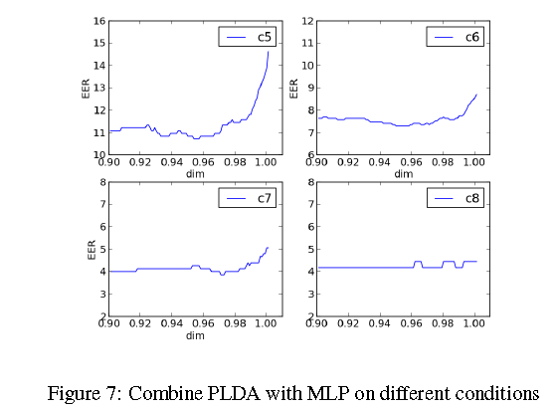

  Combine PLDA and NN
  $$Score=α{Score}_{MLP}+\left(1−α\right){Score}_{plda}$$

Slide 22
  Experiment results
EER% | c1 | c2 | c3 | c4 | c5 | c6 | c7 | c8 | c9
LDA | 24.07 | 1.49 | 24.18 | 14.56 | 14.54 | 10.25 | 6.46 | 6.58 | 1.46
PLDA | 19.50 | 2.18 | 19.71 | 14.54 | 11.22 | 8.06 | 4.27 | 4.46 | 17.22
NN | 18.23 | 0.93 | 18.82 | 15.65 | 14.63 | 8.70 | 5.07 | 4.46 | 15.56
c_method1 | 17.57 | 0.93 | 17.82 | 13.26 | 12.07 | 7.77 | 4.40 | 4.18 | 15.47
c_method2 | 17.69 | 0.93 | 18.09 | 12.94 | 12.20 | 7.89 | 4.27 | 4.18 | 15.74

Slide 23
References
[1] N. Dehak, P. Kenny, R. Dehak, et al. Front-end factor analysis for speaker verification[J]. Audio, Speech, and Language Processing, IEEE Transactions on, 2011, 19(4): 788-798.
[2] P. Kenny, G. Boulianne, and P. Dumouchel, “Eigenvoice modeling with sparse training data,” IEEE Transactions on Speech and Audio Processing, vol. 13, no. 3, pp. 345–354, 2005.
[3] A. Hatch and A. Stolcke, “Generalized linear kernels for one-versus-all classification: application to speaker recognition,” in to appear in proc. of ICASSP, Toulouse, France, 2006.
[4] A. Hatch, S. Kajarekar, and A. Stolcke, “Within-class covariance normalization for SVM-based speaker recognition,” in Proc. Int. Conf. Spoken Lang. Process., Pittsburgh, PA, Sep. 2006.
[5] S. J. Prince and J. H. Elder, “Probabilistic linear discriminant analysis for inferences about identity,” in International Conference on Computer Vision. IEEE, 2007, pp. 1–8.
[6] The NIST Year 2008 Speaker Recognition Evaluation Plan, http://www.nist.gov/speech/tests/spk/2008/sre-08_evalplan-v9.pdf.
[7] P. Kenny, G. Boulianne, P. Ouellet, and P. Dumouchel, “Joint factor analysis versus eigenchannels in speaker recognition,” IEEE Transactions on Audio, Speech, and Language Processing, vol. 15, no. 4, pp. 1435–1447, 2007.
[8] A. O. Hatch, S. S. Kajarekar, and A. Stolcke, “Within-class covariance normalization for SVM-based speaker recognition.” in INTERSPEECH’06, 2006.
[9] A. Solomonoff, C. Quillen, and W. M. Campbell, “Channel compensation for SVM speaker recognition,” in Proc Odyssey, Speaker Language Recognition Workshop 2004, 2004, pp. 57–62.
[10] S. Ioffe, “Probabilistic linear discriminant analysis,” in ECCV 2006, 2006, pp. 531–542.
[11] M. McLaren and D. V. Leeuwen, “Source-normalised-and-weighted LDA for robust speaker recognition using i-vectors,” IEEE Transactions on Audio, Speech, and Language Processing, pp. 5456–5459, 2011.
[12] N. Dehak, R. Dehak, P. Kenny, P. Ouellet, and P. Dumouchel, “Support vector machines versus fast scoring in the low-dimensional total variability space for speaker verification,” in International Conference on Spoken Language Processing - ICSLP. IEEE, 2009, pp. 1559–1562.
[13] C. S. Greenberg, V. M. Stanford, A. F. Martin, M. Yadagiri, G. R. Doddington, J. J. Godfrey, and J. Hernandez-Cordero, “The 2012 NIST speaker recognition evaluation,” 2013.

Slide 24
THANKS

