Slide 1
S-DCCRN
SUPER WIDE BAND DCCRN WITH LEARNABLE COMPLEX FEATURE FOR SPEECH ENHANCEMENT
https://arxiv.org/pdf/2111.08387.pdf
Chen Chen
2021/11/24

Slide 2
Research on different samplerate
8K Hz Narrow Band
16K Hz Wide Band
32K Hz Super Wide Band
44K Hz Full Band
Most of the recent speech enhancement approaches mainly focus on wide-band signal with a sampling rate of 16K Hz.
Research on super-wide-band or even full-band denoising is still lacked.

Slide 3
Challenges
The challenges exist in modeling more frequency bands and particularly high frequency components.
How should we model more frequency bands ?
How should we use the information in high frequency components ?
Modeling with larger dimensional features will cause higher complexity of the modeling.
How should we compress the dimension of feature ?

Slide 4
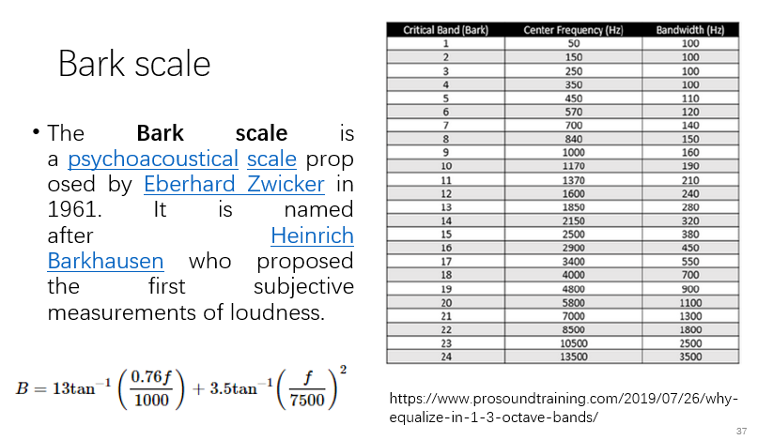
Answers of other approaches
HiFi-GAN
Use same network on different samplerate
RNNoise
Bark scale: based on human perception
PercepNet
Represent envelope from 0 to 20 kHz using 34 bands, spaced according to the human hearing equivalent rectangular bandwidth (ERB)
HiFi-GAN https://arxiv.org/pdf/2006.05694.pdf
RNNoise https://arxiv.org/pdf/1709.08243.pdf
PercepNet https://arxiv.org/pdf/2008.04259.pdf

Slide 5
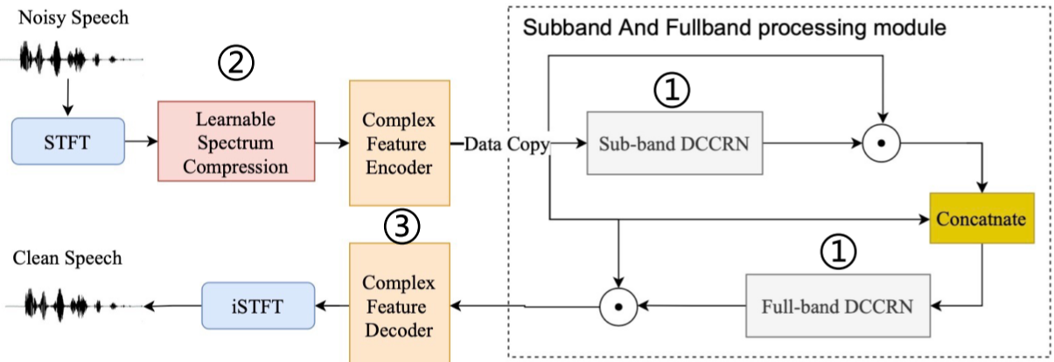
Answer of S-DCCRN

Slide 6
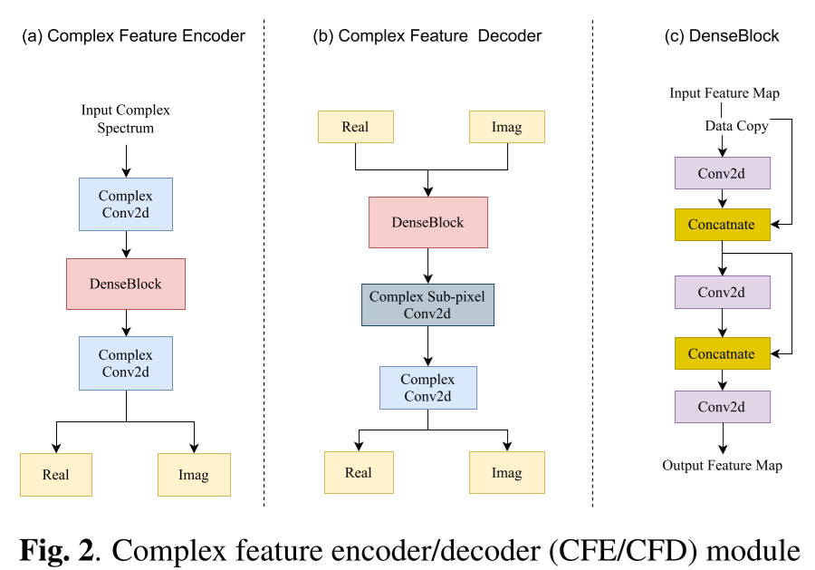
Complex Feature Encoder/Decoder
extract high dimensional information
capture long-term contextual features from time scale
extract complex local features
process the estimated real/imag features
pixel convolution is considered as a better alternative for transposed convolution to avoid checkerboard artifacts
revert the high-dimensional feature to the time-frequency domain
①
④
②
⑤
③
⑥
The STFT length is 512.
The hidden channels of the complex feature encoder/decoder module are 32.
Ashutosh Pandey and DeLiang Wang, “Densely connected neural network with dilated convolutions for real-time speech enhancement in the time domain,” in ICASSP 2020-2020 IEEE International Conference on Acoustics, Speech and Signal Processing (ICASSP). IEEE, 2020, pp. 6629–6633.
Notes:
Bark compress original physical frequency bands and discard phase information.
Features based on the human perception may not be suitable for the input of network.
Larger number of points of STFT increase the network complexity, smaller number cause the degradation of frequency resolution.

Slide 7
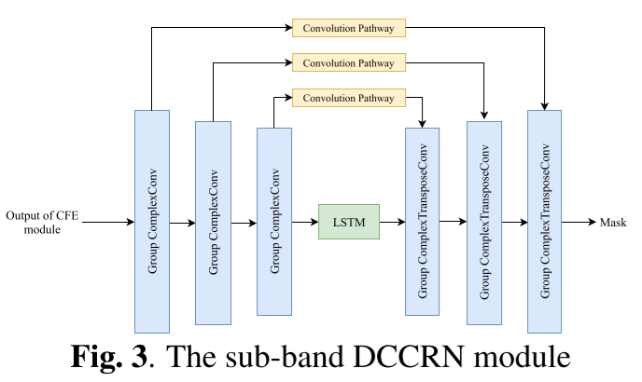
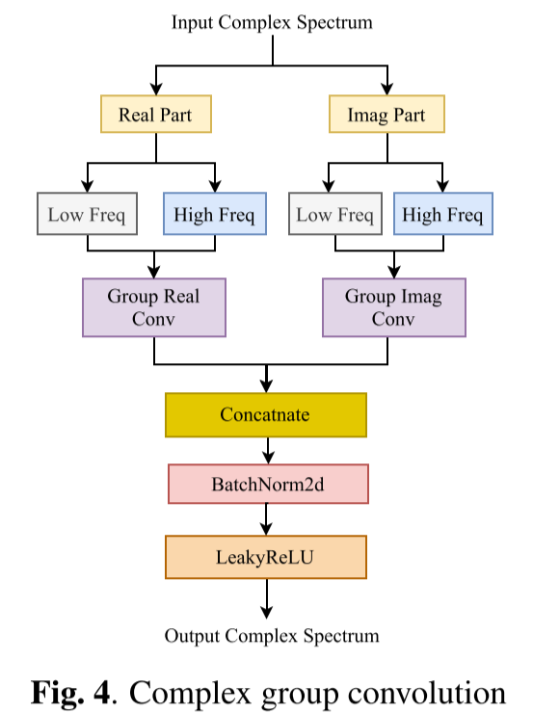
Sub-band and Full-band Processing Module
The skip pathway between encoder and decoder consists of a complex convolution block and batch normalization.

Slide 8
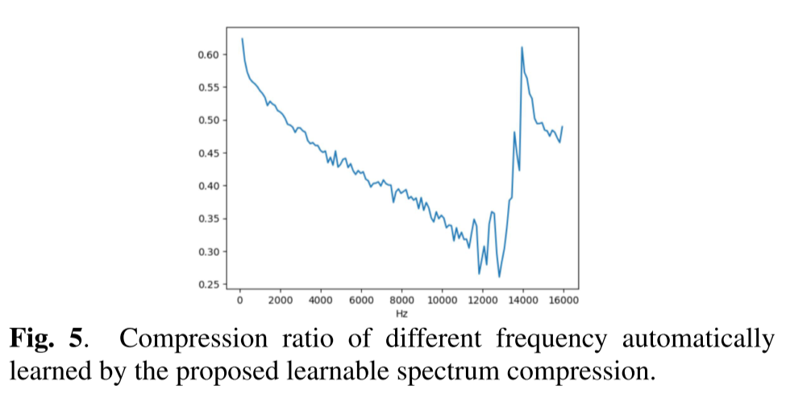
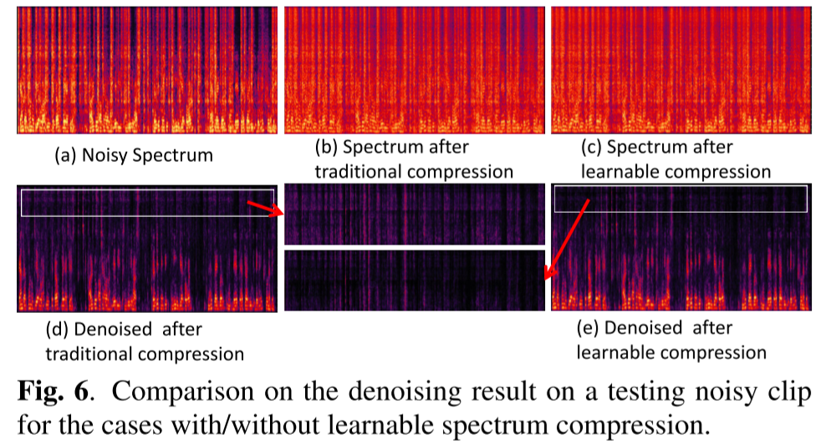
Learnable Spectrum Compression

Slide 9
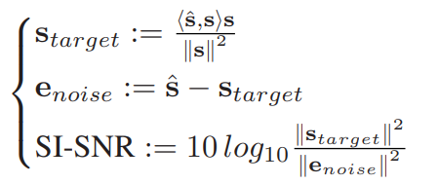
Loss Function
SI-SNR loss in time-domain
scale-invariant source-to-noise ratio
Complex mean-squared error (MSE) loss in T-F domain
Kullback-Leibler Divergence in T-F domain

Slide 10
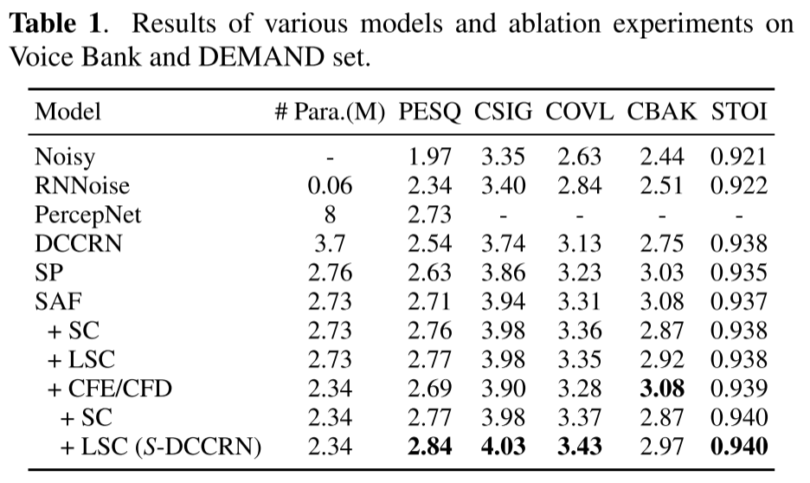
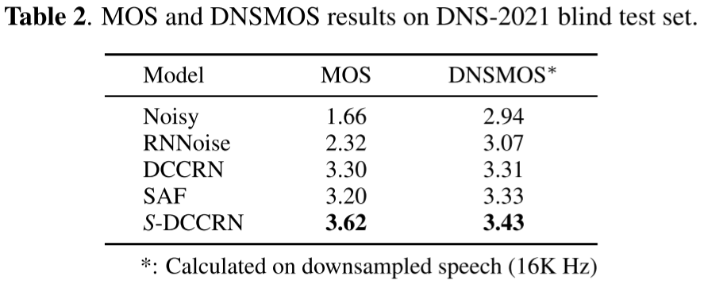
Result
Demo: https://imybo.github.io/S-DCCRN/

