Slide 1
Memoryless Document Vector
Dongxu Zhang
Advised by Dong Wang
2016.1.18

Slide 2
Introduction
What is “Memory”?
Why do we want “Memoryless”?
How to achieve that goal?

Slide 3
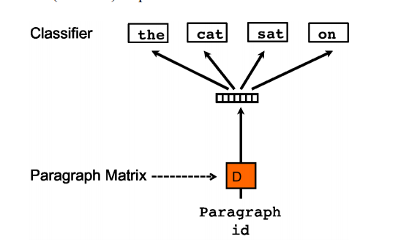

Introduction
What is “Memory”?
    Latent Semantic Indexing(LSI) [1]
      $$X=TSD^{T} →d=xTS^{−1}$$
    Probabilistic Latent Semantic Indexing(PLSI)[2]
    $$P\left(w_{j} | d_{i}\right)=\sum_{k=1}^{K}{P\left(w_{j}|z_{k}\right)P(z_{k}|d_{i})}$$
    Paragraph Vector with Distributed Bag of Words(PV-DBOW)[3]

Slide 4
Introduction
Why “Memoryless”?
Notes:
A potential problem of these low-dimensional representation methods is the inconsistency between training and prediction. In training, word and document vectors are inferred simultaneously, while in prediction, word vectors are frozen and only document vectors are inferred. An assumption behind this word-fixed inference is that the semantic information that we need to produce a document vector has been fully loaded in the parameters of word vector in the model training, and so documents can be simply derived from the semantic-loaded words in prediction. However, this is not necessarily true in practice, since the document vectors will absorb a significant proportion of information which can be used to map the word vectors into document vectors, due to the simultaneous word and document vector inference (e.g., by co-occurrence matrix factorization).

Slide 5
Introduction
How to achieve?
  Word vector pooling[4]
    Shortcoming: Does not involve pooling in model training, which leads to mismatch between word vector learning and document vector producing.
  Memoryless Document Vector

Slide 6
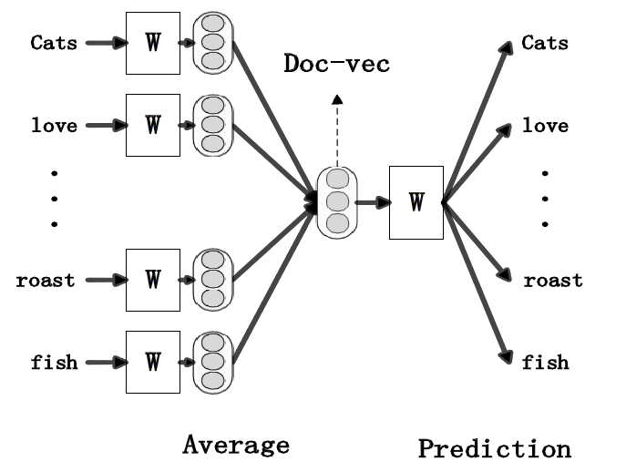
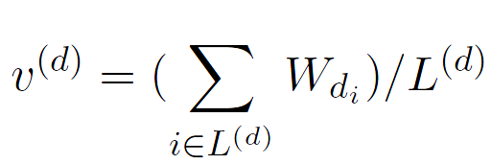
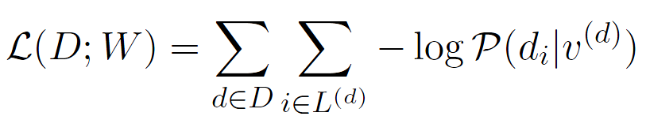
Memoryless Document Vector

Slide 7
Experiments
Datasets
  Webkb, reuters 8, 20 newsgroup
  SST, IMDB
Setup
  Topic classification tasks with 50 and 200 dimensions.
  Sentiment classification tasks with 100 and 400 dimensions.
  Logistic regression classifier.

Slide 8
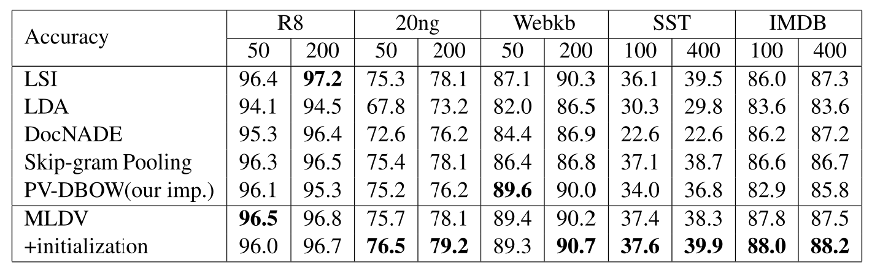
Results

Slide 9
Conclusion
  Raise up the memory issue of conventional document representation methods and then propose a simple yet effective method for document representation to nail it.
Reference
[1] S.C. Deerwester, S.T. Dumais, T.K. Landauer, G.W. Furnas, and R.A. Harshman. 1990. Indexing by latent semantic analysis. Journal of the American Society of Information Science, 41(6):391–407.
[2] Hofmann, Thomas. "Probabilistic latent semantic indexing." Proceedings of the 22nd annual international ACM SIGIR conference on Research and development in information retrieval. ACM, 1999.
[3] Quoc Le and Tomas Mikolov. 2014. Distributed representations of sentences and documents. In Proceedings of the 31st International Conference on Machine Learning (ICML-14), pages 1188–1196.
[4] Chao Xing, Dong Wang, Xuewei Zhang, and Chao Liu. 2014. Document classification based on i-vector distributions. In APSIPA 2014.

Slide 10
Thank you.

