Slide 1
OC16-CE80: A Chinese-English Mixlingual Database and A Speech Recognition Baseline
Dong Wang, Zhiyuan Tang, Difei Tang and Qing Chen
CSLT/RIIT, Tsinghua University & SpeechOcean, Inc.
http://cslt.riit.tsinghua.edu.cn
Oriental-COCOSDA, 26-28 Oct 2016, Bali, Indonesia

Slide 2
OUTLINE
> > > > >
Introduction
1
2 OC16-MixASR-CHEN Challenge
2
Challenge report
3
OC16-CE80 Database & Other Resources
4

Slide 3
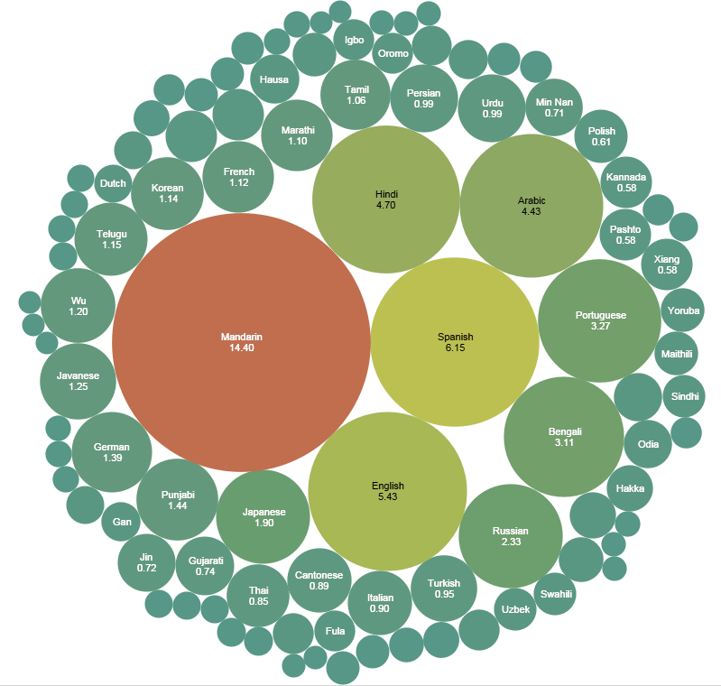
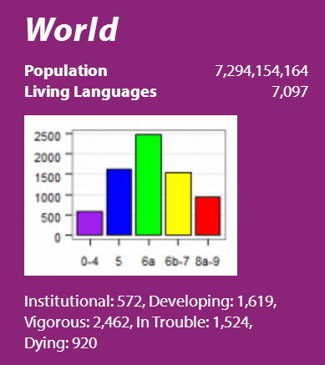
Introduction
Language phenomena:
comparative phonetics, evolutionary linguistics, language development,
sociolinguistics,
mixlingual embedding
…

Slide 4
Multilingual and Mixlingual
Reasons
International interaction
Domestic policy
Cultural integration
Categories
Multilingual
Mixlingual (code-switch)
我想买i-phone
LA
LB
L1
L2

Slide 5
Mixlingual phenomenon
Impact
Acoustic
Pronunciation change
Lexical
Foreign words
Linguistic
Borrowed new syntax
Solutions
Data
Augmentation, adaptation
Symbolic
Alias phones, phone clustering
Feature
NN sharing, AFs

Slide 6
OUTLINE
> > > > >
Introduction
1
2 OC16-MixASR-CHEN Challenge
2
Challenge report
3
OC16-CE80 database
4

Slide 7
Our goal
We believe mixlingual is attractive for research and important for industry
comparative phonetics
evolutionary linguistics
language development
sociolinguistics
We propose a challenge that promote mixlingual research
Thanks to SpeechOcean and OCOCOSDA 16!

Slide 8
OC16-MixASR-CHEH Challenge
Target:
A system for mixlingual speech recognition (Chinese-English).
Time line:
Primary submission: Jul.17; Extended submission: Sept.30
Participants:
Academic plus industrial
Development resources:
OC16-CE80 database, 60 hours, provided by SpeechOcean
THCHS30, an open Chinese database, lexicon, LM
CMU English dictionary
Evaluation metric:
$$WER=\frac{S+D+I}{N}$$

Slide 9
Baseline setup
Tool : Kaldi, WSJ s5 nnet3 recipe
AM(GMM) : MFCC, 4483 HMM states, 3500 pdfs
AM(TDNN) : Time-delay neural network,
Fbank, a symmetric 4-frame window,
p-norm(2000->250), 6 hidden layers
LM : THCHS30 + OC16 3-gram
Training : NSGD, 4 jobs parallel using NVIDIA/GPU
Decoding : WFST static decoding

Slide 10
Baseline results
 | WER%
LM | Chinese | English | Overall
THLM | 48.38 | 100.00 | 46.33
OCLM | 19.09 | 43.72 | 20.21
MIX | 19.00 | 43.67 | 20.09
JOIN | 19.30 | 43.86 | 20.37
THLM: Language Model provided by THCHS30.
OCLM: Language Model trained with the transcripts of OC16-CE80.
MIX: A mixture of THLM and OCLM.
JOIN: Language Model trained with the transcripts of OC16-CE80 and THCHS30.
 | Error%
Error type | Chinese | English | Overall
Substitution | 12.92 | 22.11 | 15.32
Deletion | 2.88 | 16.59 | 2.67
Insertion | 3.20 | 4.98 | 2.11
Different types of errors for the system using MIX LM.

Slide 11
OUTLINE
> > > > >
Introduction
1
2 OC16-MixASR-CHEN Challenge
2
Challenge report
3
OC16-CE80 database
4

Slide 12
Primary submission
Submission ID | Chinese WER% | English WER% | Overall WER%
Samsung China R&D | 14.53 | 26.78 | 14.75
Shanghai Normal Univ. | 15.98 | 28.28 | 16.11
Academia Sinica, Taiwan | 19.42 | 28.20 | 19.05
Rokid | 22.44 | 37.02 | 21.84
National Taipei University of Technology | 29.14 | 39.24 | 28.18
Anonymous Company | 30.76 | 75.65 | 29.16
More than 10 downloads, 6 submissions.

Slide 13
Extended submission
Prof. Yuanfu Liao from National Taipei University of Technology!
Overall performance Rank2
English performance Rank1
Notes:
Participant 3: Yuan-Fu Liao, National Taipei University of Technology,
yfliao@mail.ntut.edu.tw

Slide 14
OUTLINE
> > > > >
Introduction
1
2 OC16-MixASR-CHEN Challenge
2
Challenge report
3
OC16-CE80 database
4

Slide 15
OC16-CE80
How English Strongly Influences Other Languages?
I have a meeting in the afternoon
Chinese + English _ 我下午要去参加一个meeting
Hindi + English _Meri meeting Hai afternoon ma
Indonesian + English _ Saya pergi untuk meeting pada siang hari
Korean + English _저는 오늘 오후에 meeting 있습니다
Japanese + English _午後はmeetingに出席します
Chenqing@speechocean.com

Slide 16
OC16-CE80
OC16-CE80
Parameters
Language | Mandarin/English Embedded
Recording Channel | Mobile/Android+iOS+Window
Utterances/Speakers | 50
Parameter | 16 KHz, 16 Bit, Mono Channel
Script Design | Dialog, SMS, SNS, Newspaper….
Data Set | Training Set | Dev. Set | Test Set | Total
No. of Speakers | 1163 | 140 | 142 | 1445
Utterances | 58,132 | 6,974 | 7,099 | 72205
Recording Hours | 63.8 | 7.76 | 7.93 | 79.49
Chenqing@speechocean.com

Slide 17
OC16-CE80
OC16-CE80
Recording Platform
.
Platform | Phone Type | Speakers (%)
iOS | iPhone 3GS, iPhone 4 | 29.0%
Android | HTC Legend (G6), HTC Aria (G9), Samsung i909, | 49.5%
 | Samsung Nexus-S9020, HTC G18, MOTO XT615
Windows Mobile | HTC t2222,Samsung i900 | 21.5%
Chenqing@speechocean.com

Slide 18
OC16-CE80
OC16-CE80
Gender & Age Distribution
Age Group | # Speakers (%)
18 – 35 years | 64.4%
36 – 45 years | 24.9%
46+ years | 10.6%
Female | Male
48.9% | 51.1%
Chenqing@speechocean.com

Slide 19
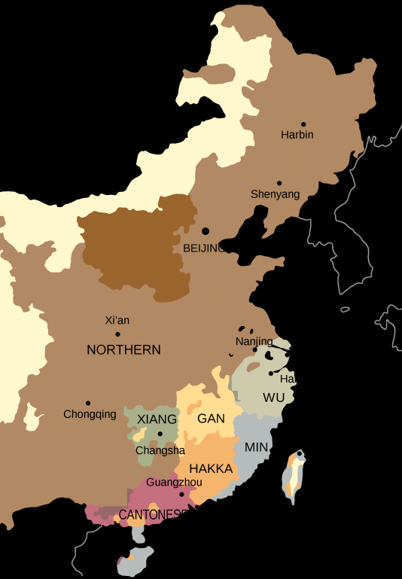
OC16-CE80
OC16-CE80
Accents Distribution
City | Dialect | # Speakers
Beijing | Northern | 185
Changsha | Xiang | 185
Chengdu | Northern | 185
Guangzhou | Cantonese | 185
Haerbin | Northern | 185
Jinan | Northern | 185
Nanchang | Gan | 185
Nanjing | Wu | 185
Nanning | Hakka/Cantonese | 142/42
Shanghai | Wu | 185
Wuhan | Northern | 185
Xi’an | Northern | 185
Xiamen | Min | 185
Zhengzhou | Northern | 185
94.3% Population
Chenqing@speechocean.com

Slide 20
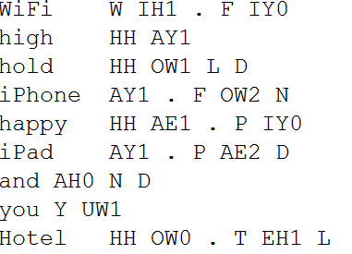
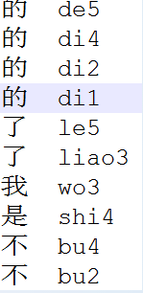
OC16-CE80
OC16-CE80
Transcription & Lexicon
Transcription
Pronunciation Lexicon
Chenqing@speechocean.com

Slide 21
More Mix Corpus…
Other Mix-lingual Corpus
A Taiwanese-English Mix-Lingual Speech Corpus
_ King-ASR-360
Language | Taiwanese / English Embedded
Recording Channel | Mobile
No. of Speakers | 1026 Speakers
Recording Hours | 514 Hours
Utterances | 321,890 Utterances
Parameter | 16 KHz, 16 Bit, Mono Channel
Script Design | Dialog, SMS, SNS, Newspaper….
Recording Environment | Office, Restaurant, Streets…
Time of Building | 2016-3-28
Chenqing@speechocean.com

Slide 22
Other Mix-lingual Corpus
More Mix Corpus…
Mix-Lingual Speech Corpus Under-Construction
Corpus | # Speakers | Recording Hours
Japanese + English | 1600 | 800
Korean + English | 1500 | 750
Indonesian + English | 1200 | 600
Hindi + English | 1800 | 900
Chenqing@speechocean.com

Slide 23
More Resources
Data Resources Overview
Existing Data Resources Overview
Data Type | Language Coverage | Data Volume
TTS | 35 Languages | 520 Hours
ASR | 65 Languages | 85,000+ Hours
Lexicon | 48 Languages | 5 Million Entries
Text | 31 Languages | 600 Million Annotated Words
What’s Unique?
Diversities
In-Car Corpus
Spontaneous Corpus
Telephony Corpus
Non-Native Speaker Corpus
Far-Filed Recording
Children Speech
….
Uniqueness
North Korean
Hebrew
Catalan
Urdu
Ukrainian
Uygur
Tibetan
…

Slide 24
Cooperation
Cooperation
Welcome to Approach Us for …
Phonetic & Phonological Analysis
Speech Recognition
Speaker Recognition
Language Recognition
Language Understanding
Speech Synthesis
… …
Chenqing@speechocean.com

Slide 25
Other Challenge
Cooperation
Oriental Languages Recognition
Special Session & Challenge in APSIPA2016
Language | Cantonese in China (Mainland and HK) Mandarin in China Indonesian in Indonesia Japanese in Japan Russian in Russia Korean in Korea Vietnamese in Vietnam
Recording Channel | Mobile/Android+iOS+Window
No. of Speakers | 18 Speakers / Language
Recording Hours | 71 Hours
-Training Set | 53 Hours
-Testing Set | 17 Hours
Chenqing@speechocean.com

Slide 26
Cooperation
Other Challenge
Oriental Languages Recognition Challenge
in APSIPA2016
Challenge is Still Open Up-to … …
10th. Dec.2016
wangdong99@mails.tsinghua.edu.cn
Chenqing@speechocean.com
Chenqing@speechocean.com

Slide 27
Data In Min. Cost
Data With Minimum Cost
KingLine Data Center
Share
Exchange
Distribution
 Free Membership that never expires;
 500+ Commercial Corpus, 300+ Academic Corpus;
 Many ways to earn credits & Exchange data with credits;
 Best way to earn credits: share data with us, or distribute data by us
Chenqing@speechocean.com

Slide 28
Data In Min. Cost
Data With Minimum Cost
Don’t Miss Any Free Data !
28 Free Corpora Have Been Promoted This Year!
Chenqing@speechocean.com

Slide 29
Many Thanks to
Tsinghua University & Cocosda2016
Chenqing@speechocean.com

Slide 30
Thanks a lot.

